Slide 1
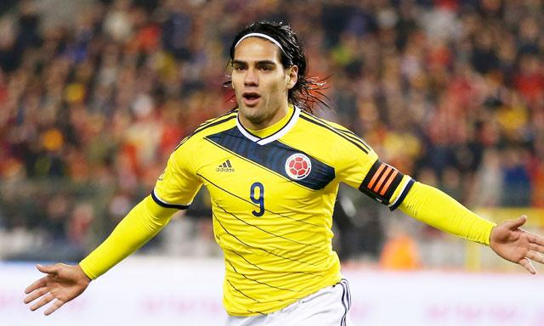
be
b
e
I want to be a great soccer player.

Slide 2
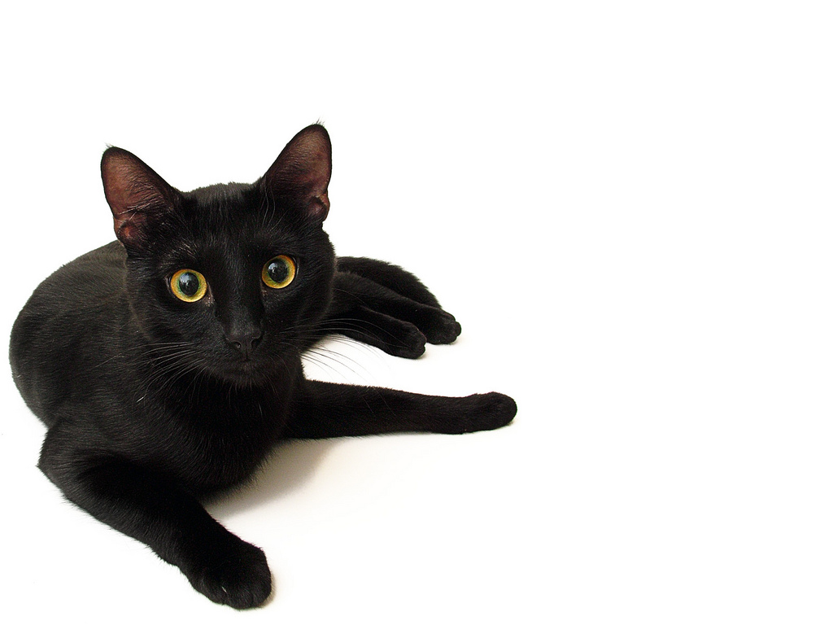
black
Meow!
b
l
a
c
k
I saw a black cat.

Slide 3
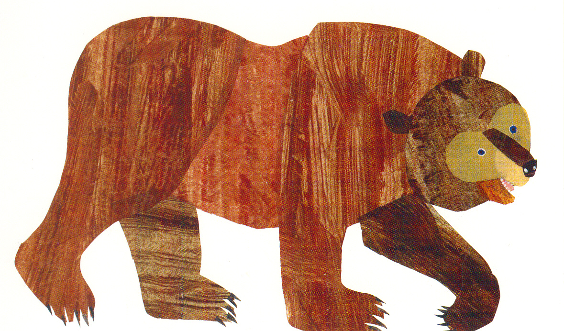
brown
b
r
o
w
n
Brown Bear, Brown Bear,
what do you see?

Slide 4
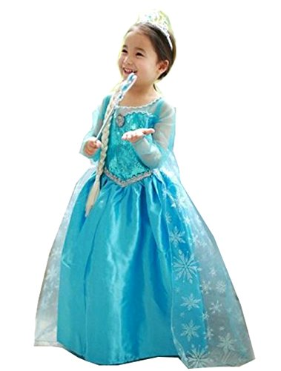
but
b
u
t
I like pink, but my favorite
dress is blue.

Slide 5
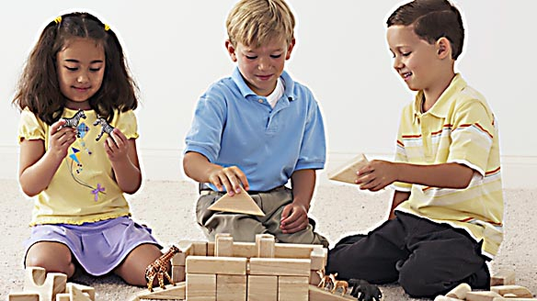
came
c
a
m
e
My friends came to play with me.

