Slide 1
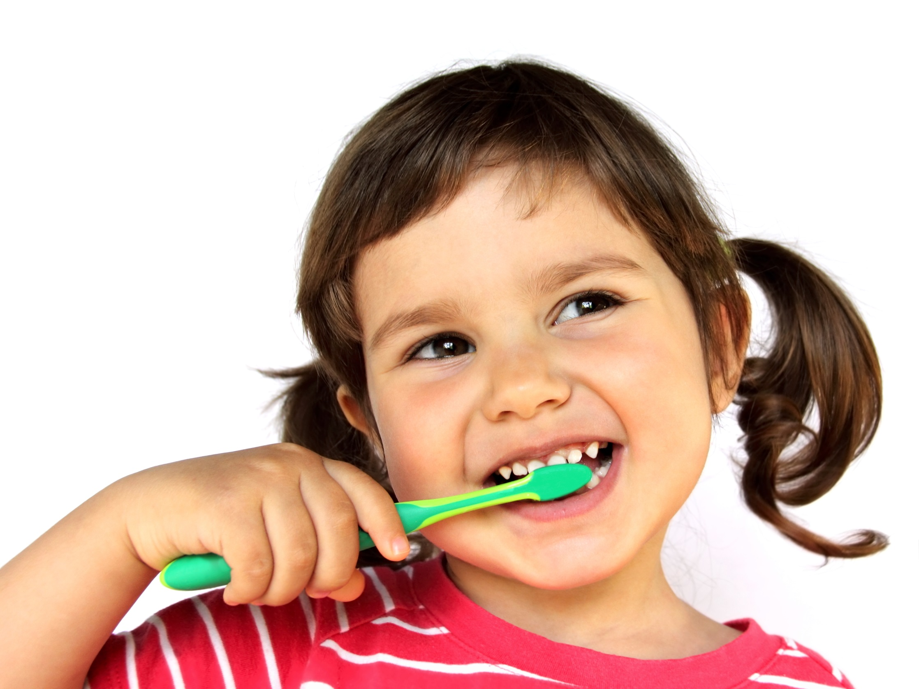
did
d
i
d
Did you brush your
teeth this morning?

Slide 2
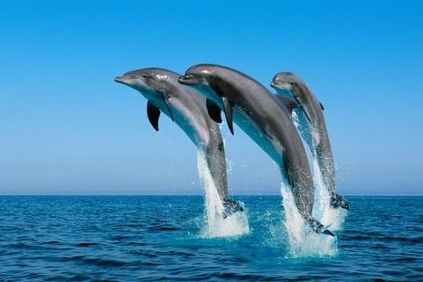
do
d
o
Do you like dolphins?

Slide 3
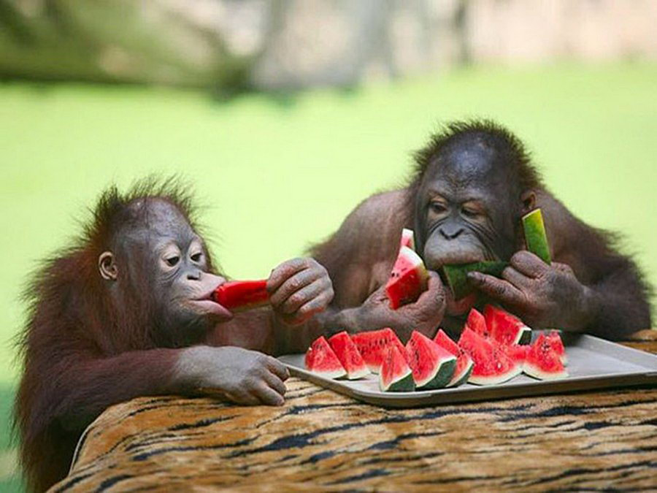
eat
e
a
t
They really like to eat watermelon.

Slide 4
four
Clic here
f
o
u
r
The number of the day is four.

Slide 5
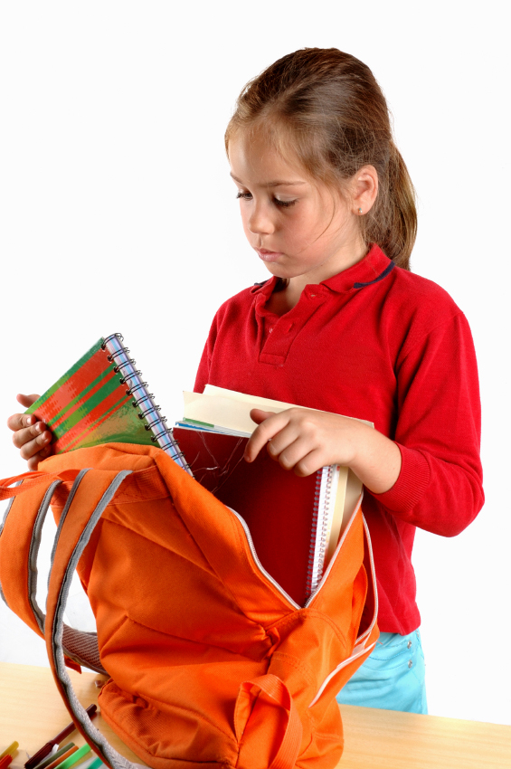
get
g
e
t
Let´s get ready for school!

