Slide 1
good
I think about what I read
g
o
o
d
I am a good reader!

Slide 2
have
h
a
v
e
I have this Math book.

Slide 3
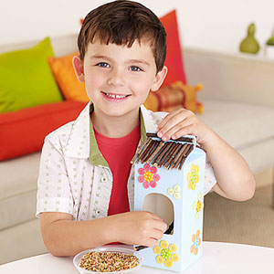
he
h
e
He made this bird feeder.

Slide 4
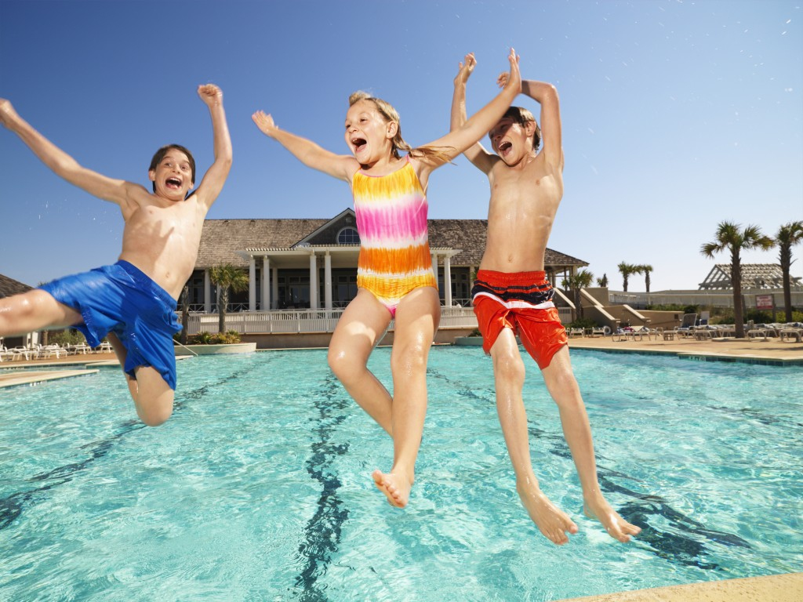
into
i
n
t
o
We jumped into the pool.

Slide 5
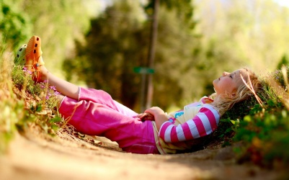
like
l
i
k
e
Sometimes, I like to be alone and think.

