Slide 1
our
o
u
r
Our school mascot is the eagle.

Slide 2
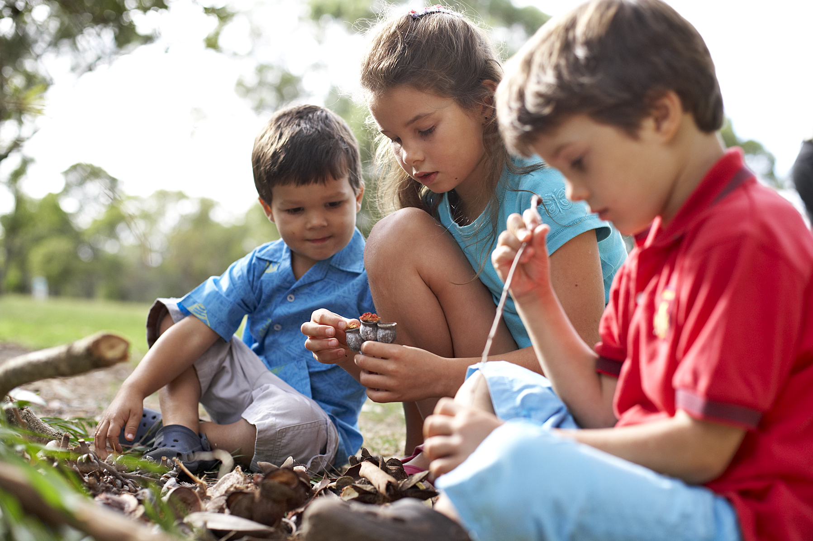
out
o
u
t
I go out to play with my friends.

Slide 3
please
p
l
e
a
s
e
Please is an important word.

Slide 4
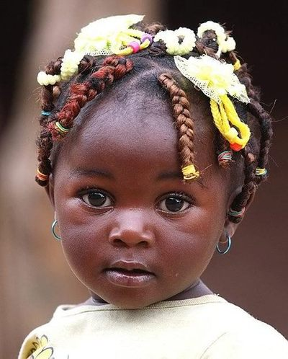
pretty
p
r
e
t
t
y
She is very pretty!

Slide 5
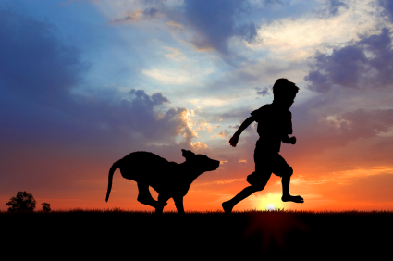
ran
r
a
n
Yesterday, I ran with my dog.

