Slide 1
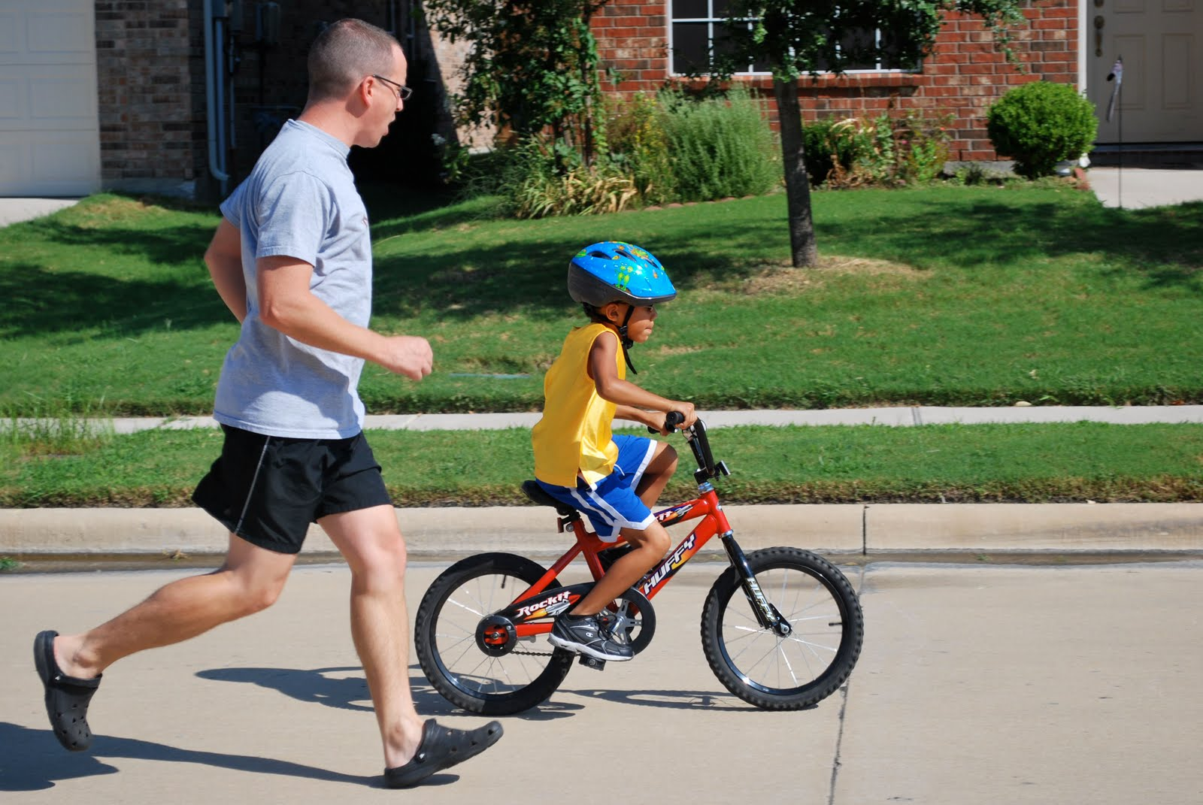
ride
r
i
d
e
I am learning to ride a bike.

Slide 2
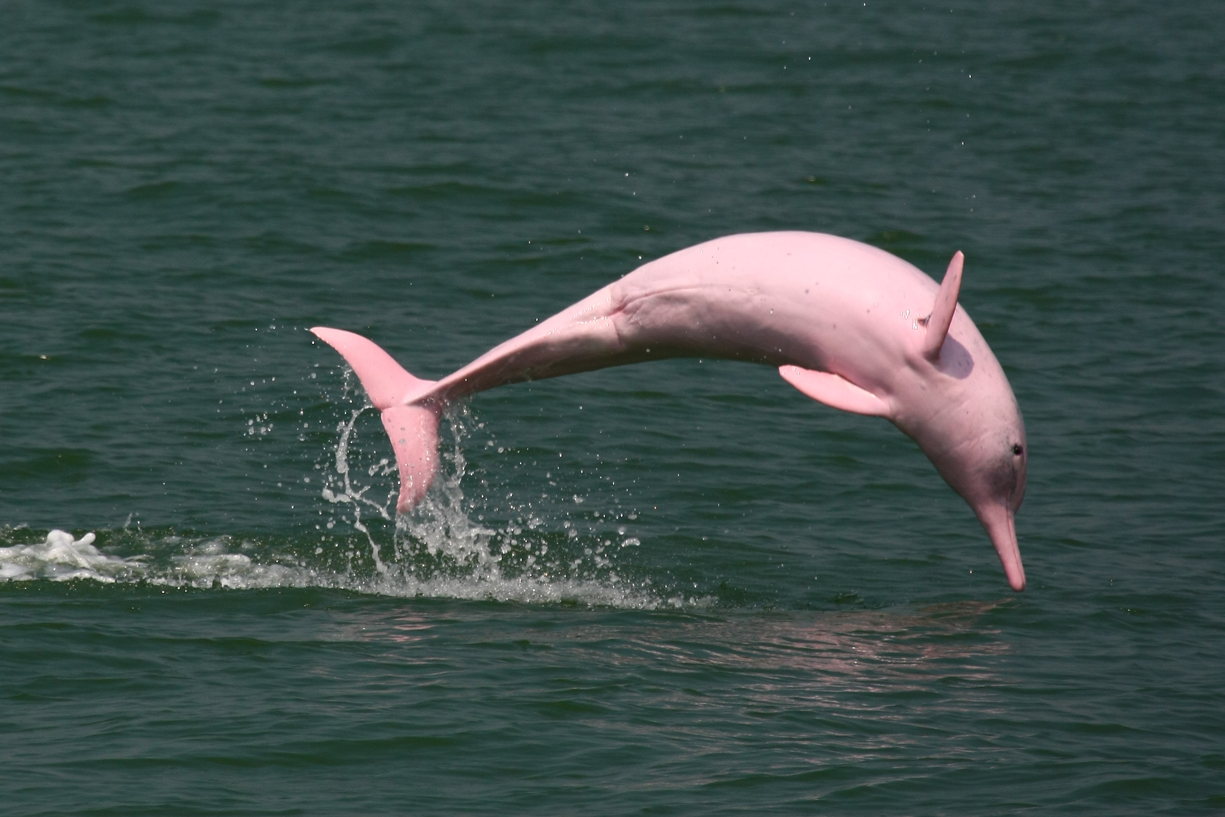
saw
s
a
w
I saw a pink dolphin.

Slide 3
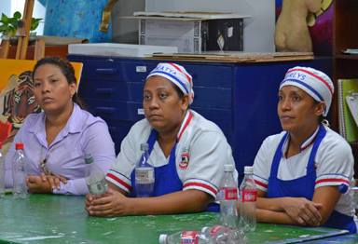
say
s
a
y
I say “please” and “thank you” to the cafeteria workers.

Slide 4
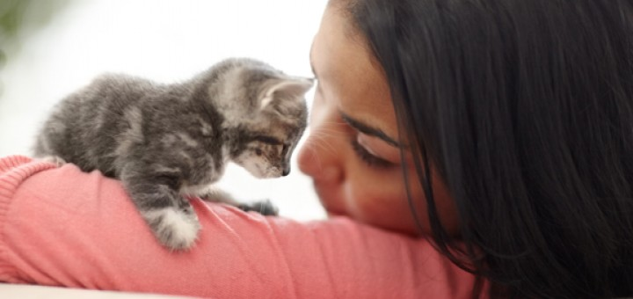
she
s
h
e
She has a new friend.

Slide 5
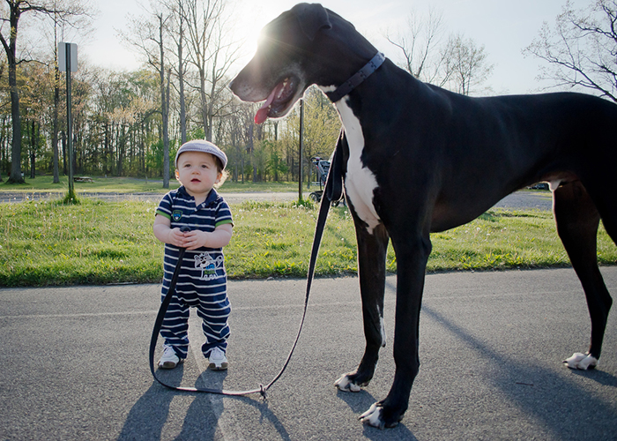
so
s
o
This dog is so big!

