Slide 1
soon
s
o
o
n
Valentine’s day is coming soon!

Slide 2
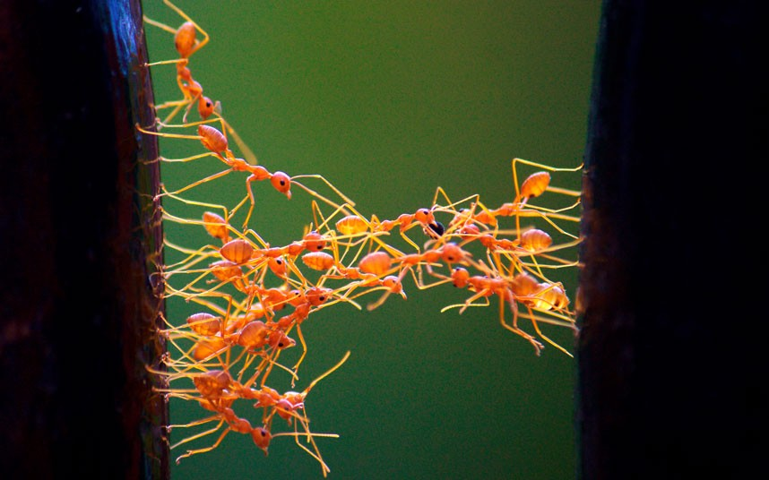
that
t
h
a
t
That is cooperation!

Slide 3
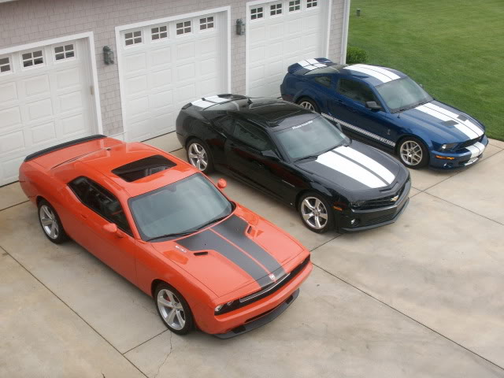
there
t
h
e
r
e
There are three cars here.

Slide 4
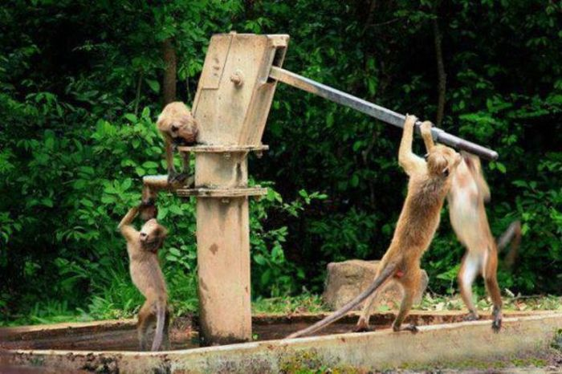
they
t
h
e
y
They are working together.

Slide 5
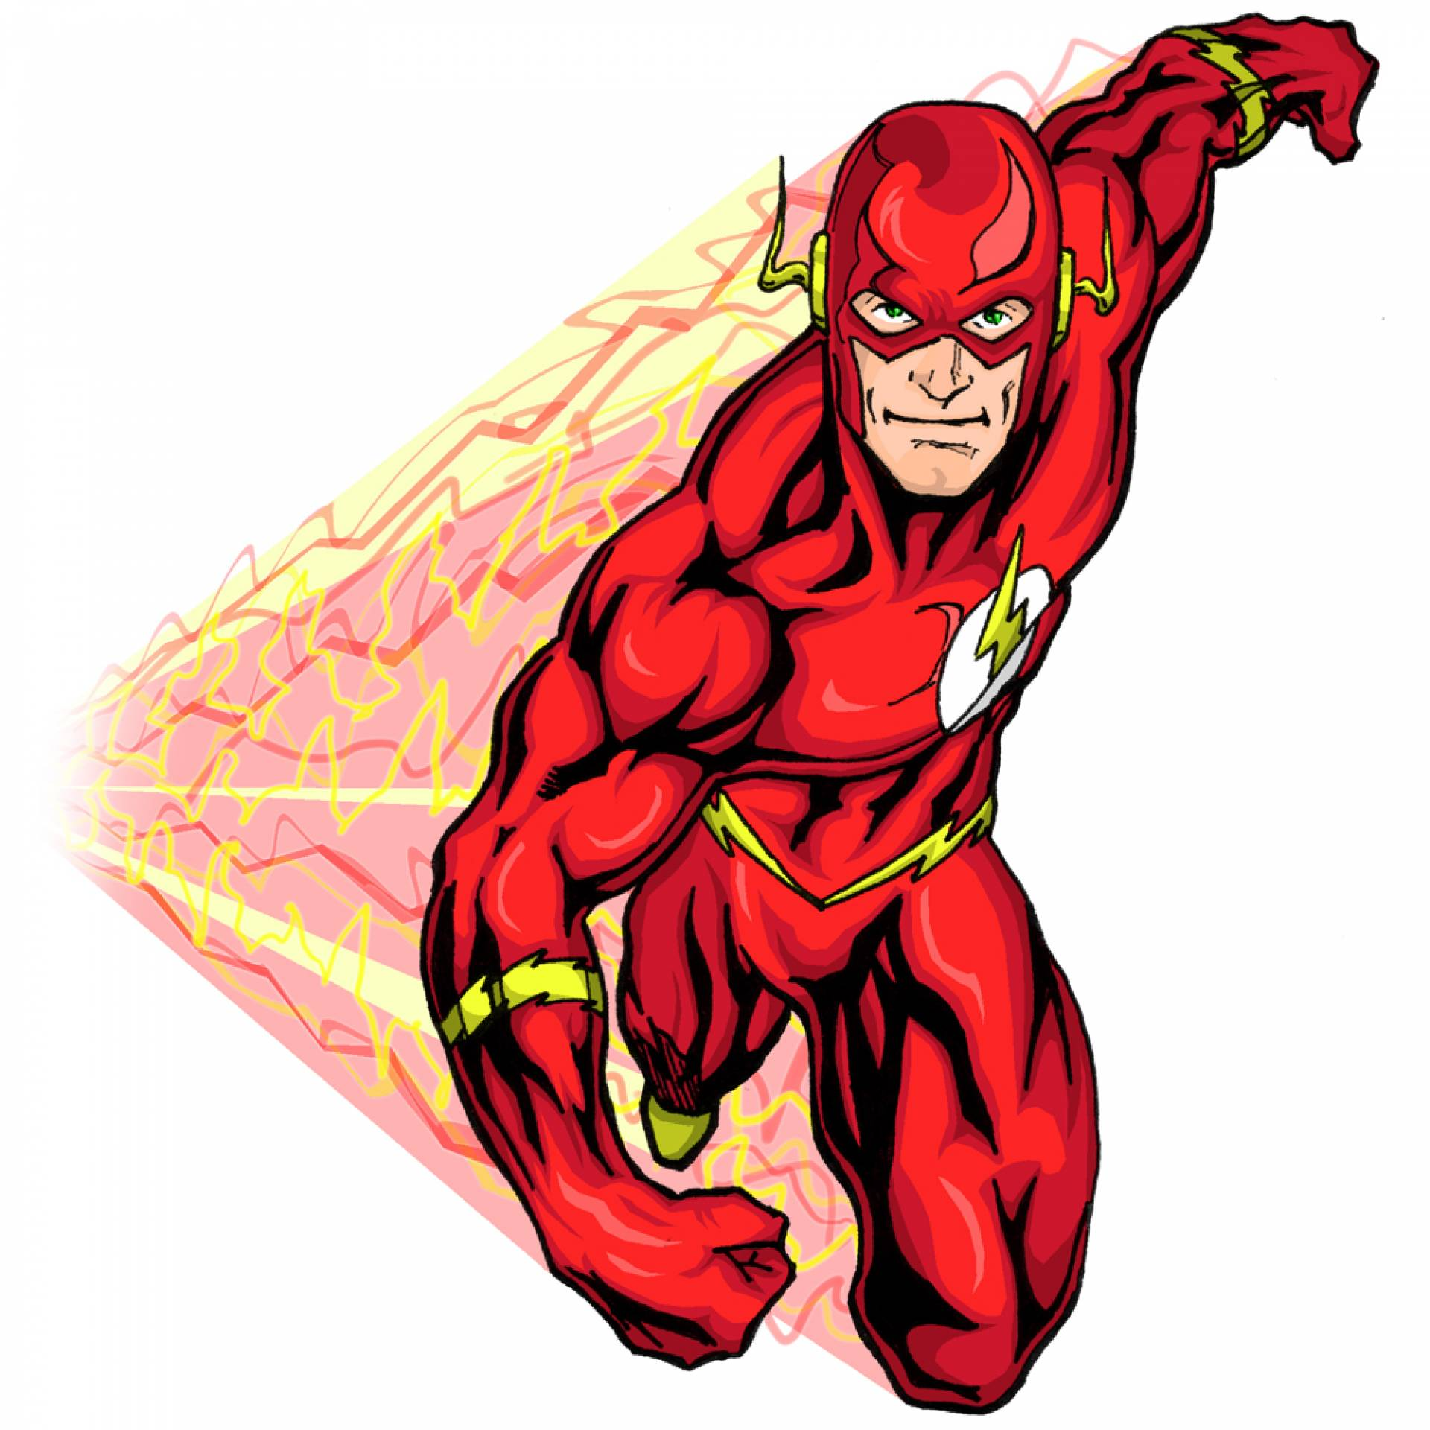
this
t
h
i
s
This is Flash.

