Slide 1
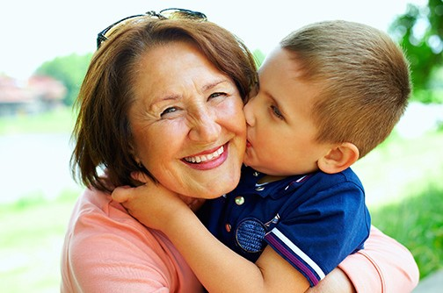
went
w
e
n
t
Yesterday, I went to my
grandma’s house.

Slide 2
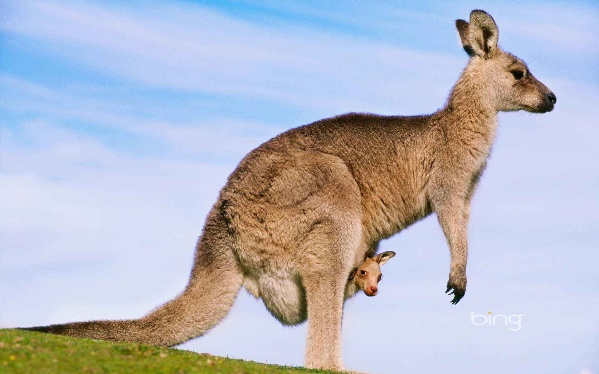
what
w
h
a
t
What animal is this?

Slide 3
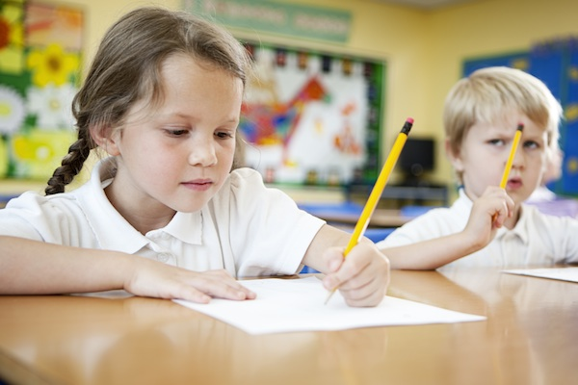
while
w
h
i
l
e
While I am at school,
my mom is at work.

Slide 4
who
w
h
o
Do you know who this is?

Slide 5
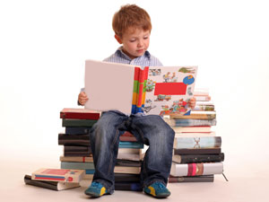
will
w
i
l
l
Today I will work on my stamina!

