Slide 1
any
a
n
y
You can read any of these books.

Slide 2
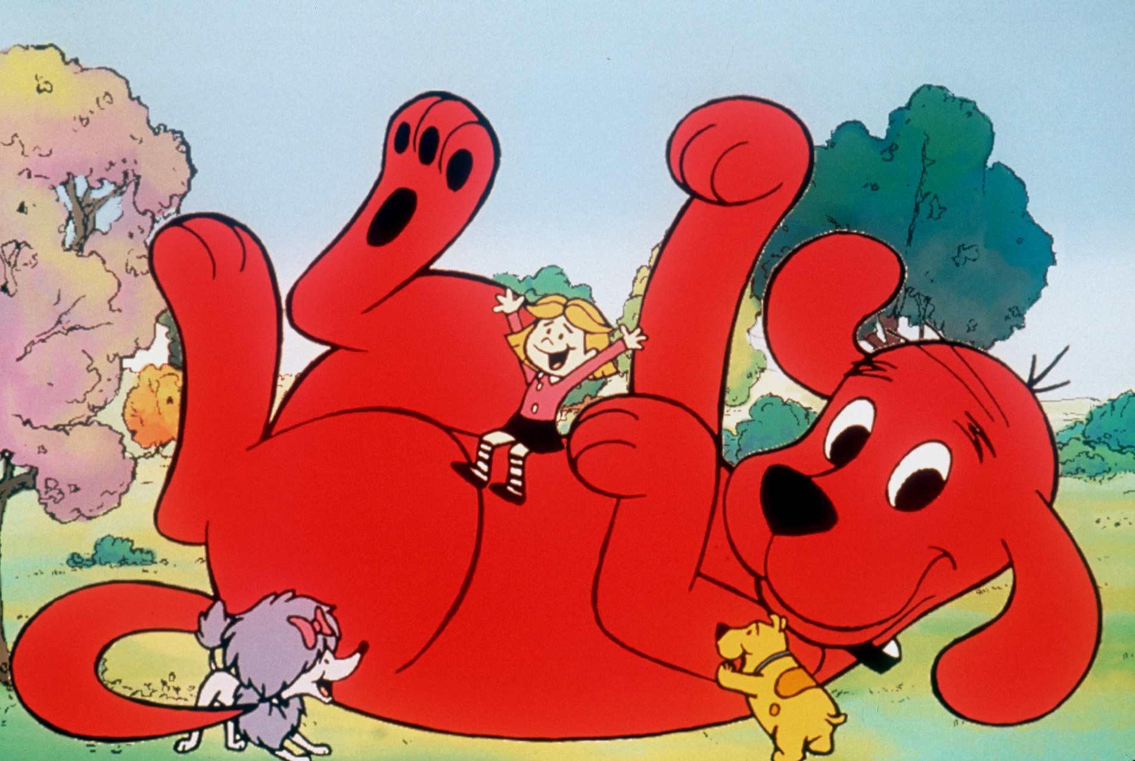
as
a
s
Clifford is as big as a house.

Slide 3
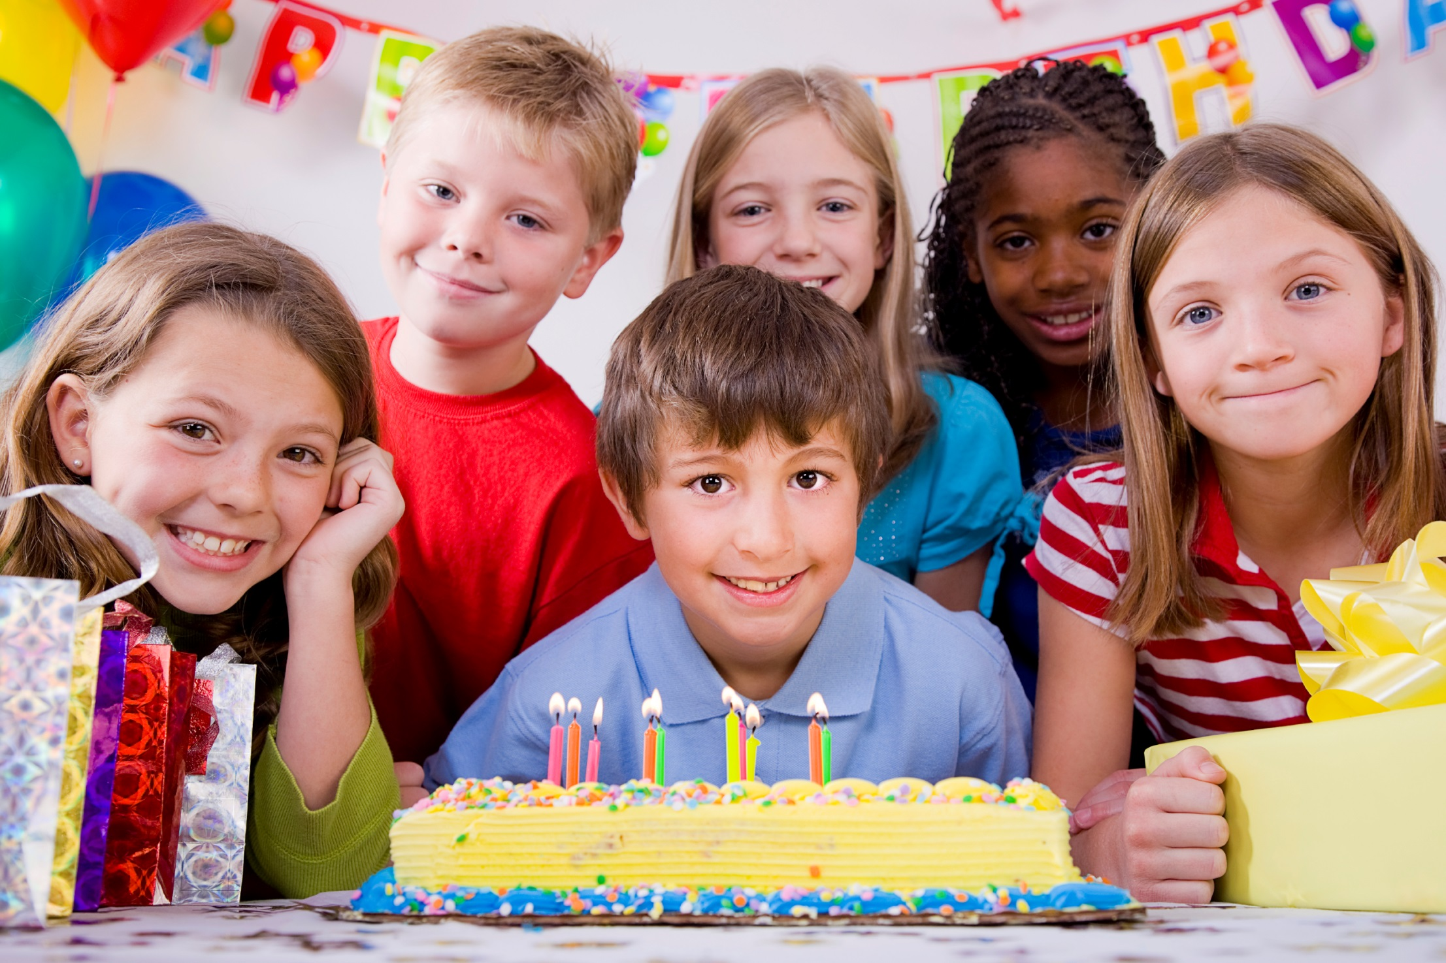
ask
a
s
k
I need to ask my mom
to go to your birthday party.

Slide 4
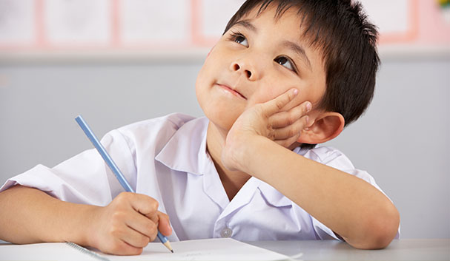
by
b
y
I can write complete
sentences all by myself!

Slide 5
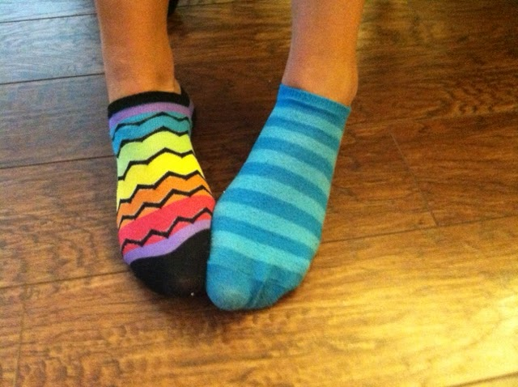
could
c
o
u
l
d
I could not find the other side!

