Slide 1
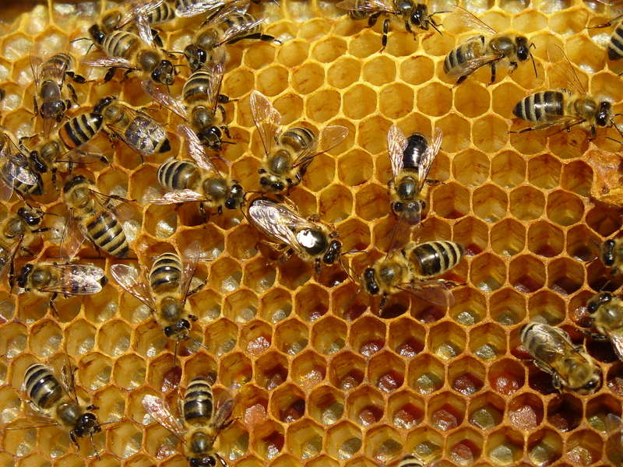
how
h
o
w
How do bees build their home?

Slide 2
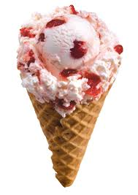
just
j
u
s
t
I’m not hungry because I just had some ice cream.

Slide 3
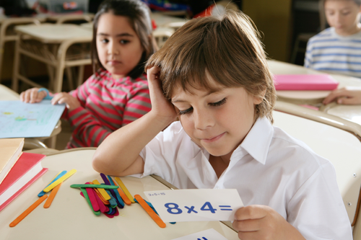
know
k
n
o
w
I don’t know how to multiply.

Slide 4
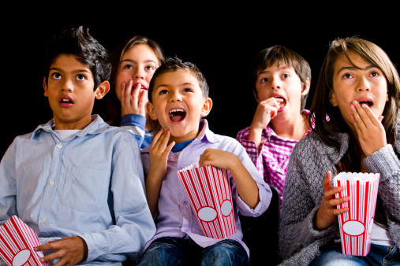
let
l
e
t
My mom let me go to the movies with my friends.

Slide 5
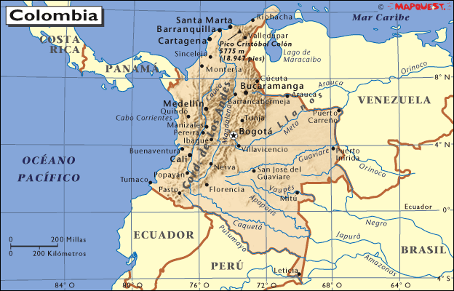
live
l
i
v
e
I live in Colombia.

