Slide 1
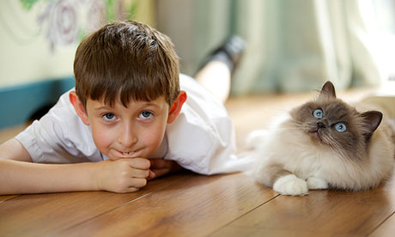
a
a
I have a cat.

Slide 2
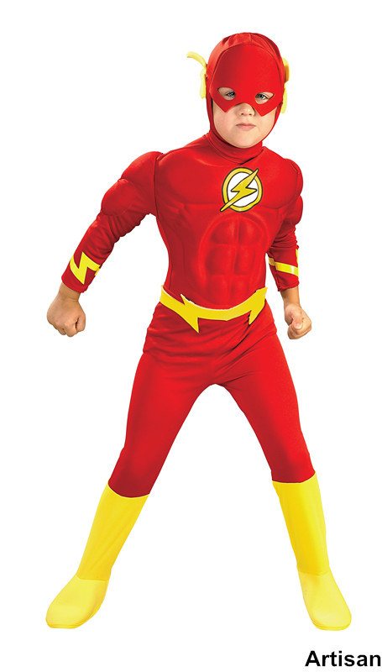
and
a
n
d
Flash is red and yellow.

Slide 3
away
a
w
a
y
My balloon flew away.

Slide 4
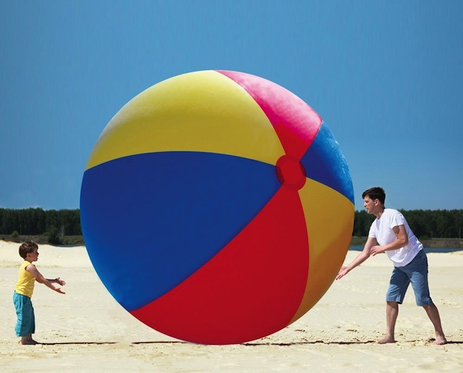
big
b
i
g
That is a big ball.

Slide 5
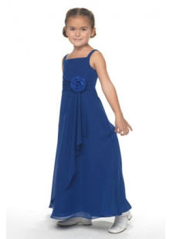
blue
b
l
u
e
That blue dress is long.

