Slide 1
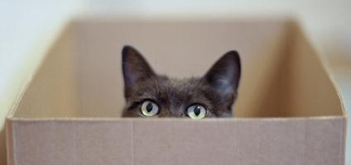
in
i
n
There is a cat in the box.

Slide 2
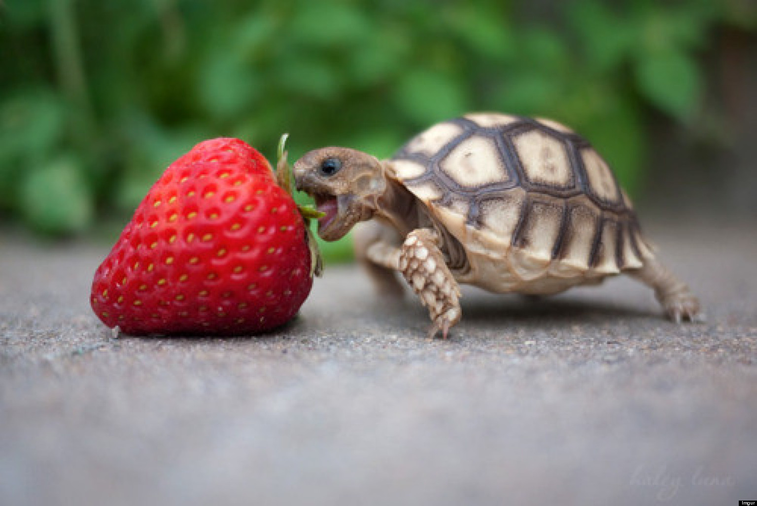
is
i
s
That is a red, ripe strawberry.

Slide 3
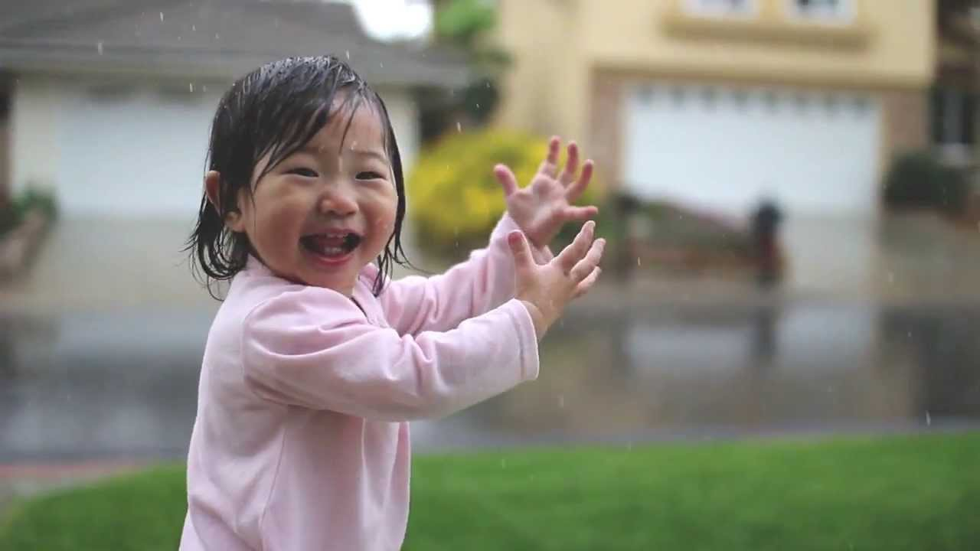
it
i
t
It is rainy.

Slide 4
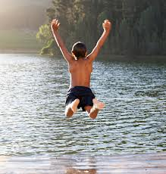
jump
j
u
m
p
I like to jump in the water.

Slide 5
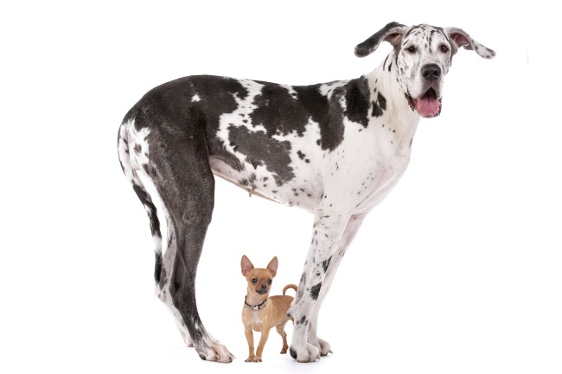
little
The brown dog is little.

