Slide 1
can
c
a
n
She can ride a bike.

Slide 2
come
c
o
m
e
Maria did not come to school today.

Slide 3
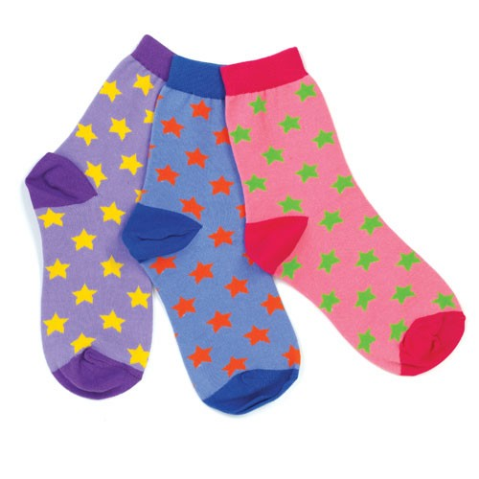
find
f
i
n
d
I could not find socks.

Slide 4
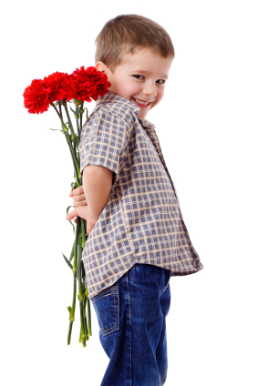
for
f
o
r
Those flowers are for his mom.

Slide 5
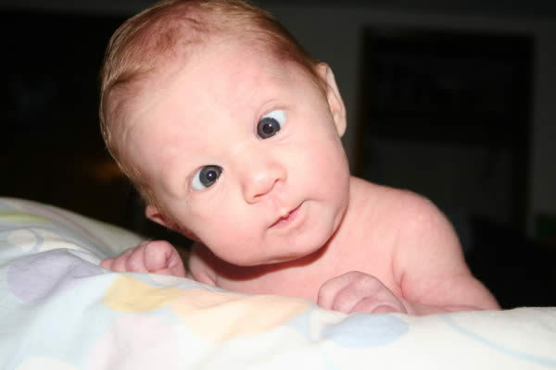
funny
f
u
n
n
y
He makes funny faces.

