Slide 1
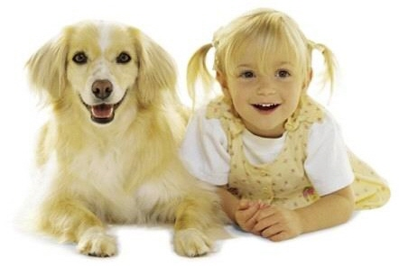
look
l
o
o
k
They look alike.

Slide 2
make
m
a
k
e
I can make a paper plane.

Slide 3
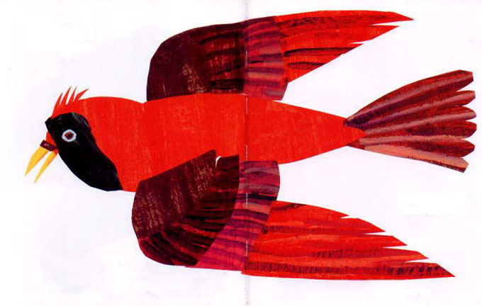
me
m
e
I see a red bird looking at me.

Slide 4
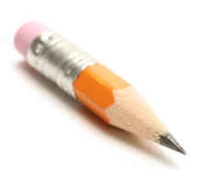
my
m
y
My pencil is short.

Slide 5
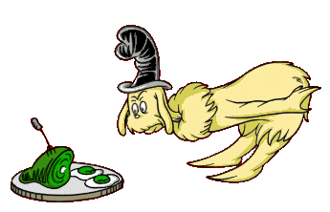
not
n
o
t
I do not like green eggs and ham.

