Slide 1
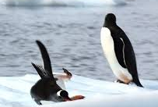
down
d
o
w
n
The penguin fell down.

Slide 2
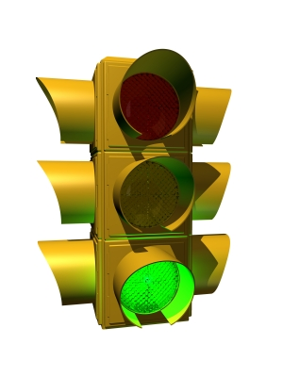
go
g
o
Green light means go.

Slide 3
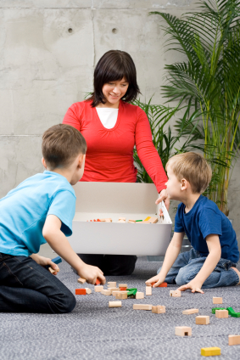
help
h
e
l
p
These boys help their mom.

Slide 4
here
h
e
r
e
I go to school here.

Slide 5
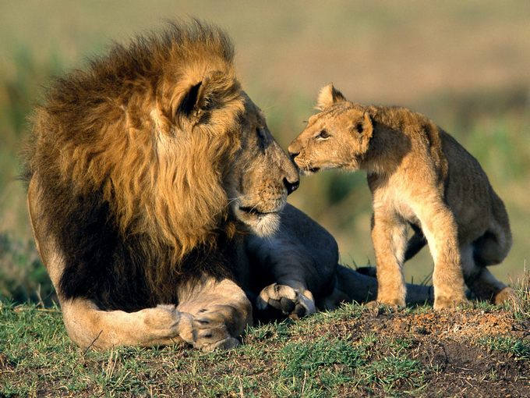
I
I
I love animals!

