Slide 1
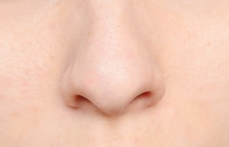
one
o
n
e
I have one nose.

Slide 2
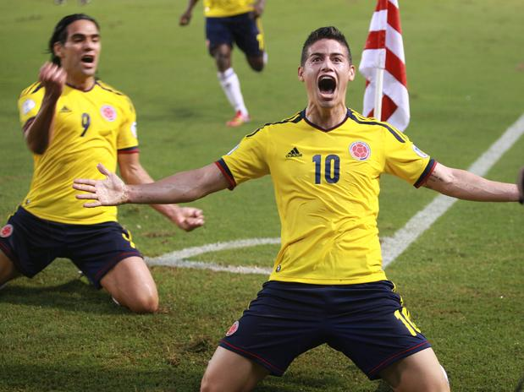
play
p
l
a
y
I love to play soccer.

Slide 3
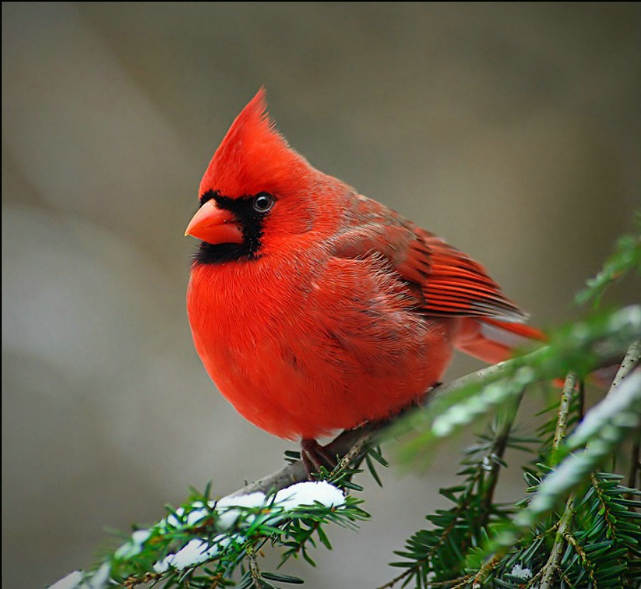
red
r
e
d
That is a red bird.

Slide 4
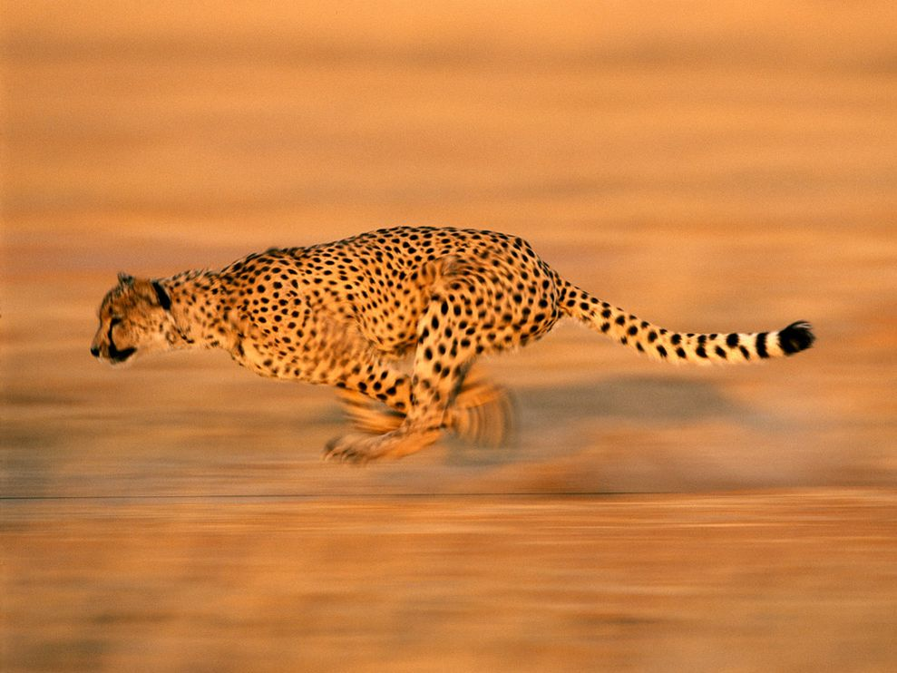
run
r
u
n
Cheetahs run really fast.

Slide 5
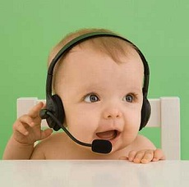
said
s
a
i
d
The baby said hi.

