Slide 1
Welcome to 1A!
Meet Ms. Cattieu and Ms. Meli!
Take a look at our room!

Slide 2
My Contact Information: Ms. Maureen Cattieu maureen.cattieu@cojowa.edu.co
http://cojowa1a.weebly.com/

Slide 3
Did everyone have time to fill out the Parent & Child Information Sheet?
Thank you!

Slide 4
SCHEDULE
SCHEDULE WEEBLY 1A

Slide 5
Reading & Math Logs:
All students will have a reading and math log. Students are required to fill in the titles of the books they read on RazKids Monday-Thursday and then turn in the reading log on FRIDAY. Likewise, they will have an IXL Math Skill log, which will have selected skills for them to practice during the week and require a parent signature upon completion.

Slide 6
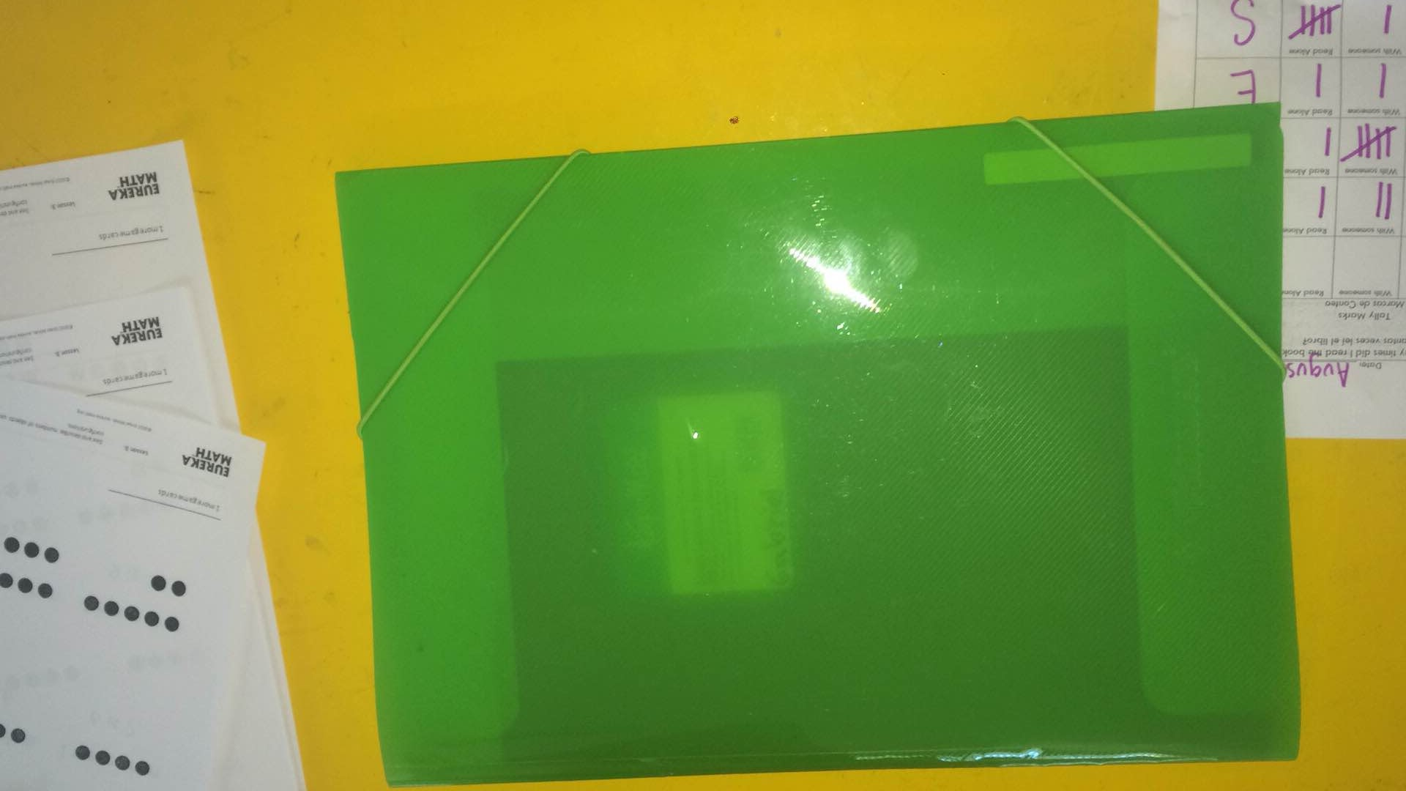
Agenda in the Homework Folder
Everyday!

Slide 7
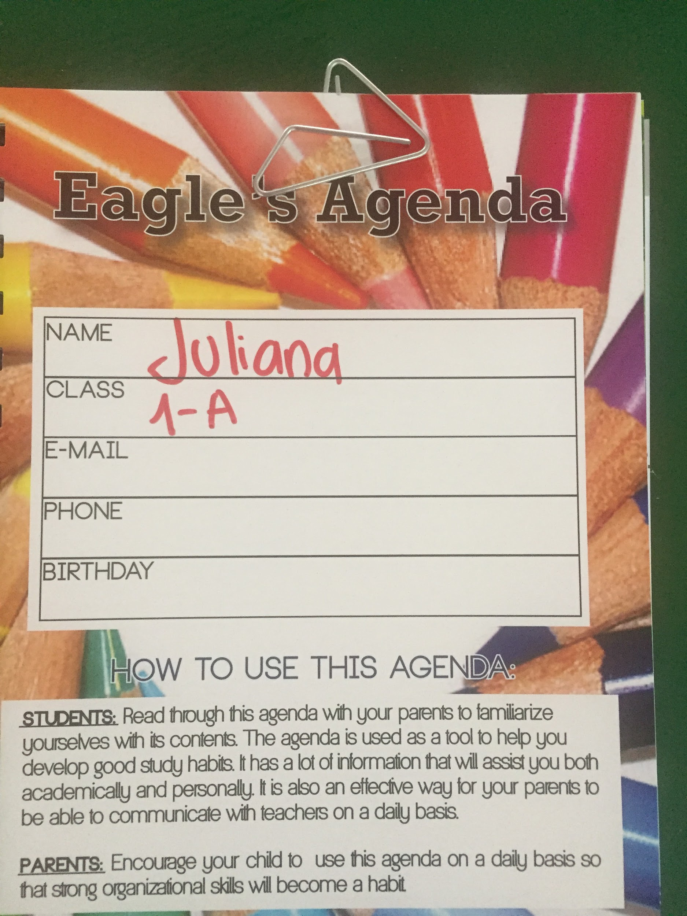
Please fill in all your child´s information on the front page of the Agenda

Slide 8
Homework Folder comes to school everyday with the agenda inside it!

Slide 9
How to Fill in the Reading & Math Log!
We will take a look at an example together...

Slide 10
Every week students will receive a Reading and Math Log. They will have until Friday to complete the log. On the backside of the log, you will see a list of the spelling words or letter sounds we are working on during the week, so that you can practice at home with your child.
In addition to the log they will also have some math worksheets, if necessary.
Homework
If the paper is folded in half, the long way- IT STAYS HOME!

Slide 11
IF your child DOES NOT understand
Circle the question in a marker or colored pen and have them return with the homework the next day. Tell the child to show the teacher and we will review it in class with all the other students!

Slide 12
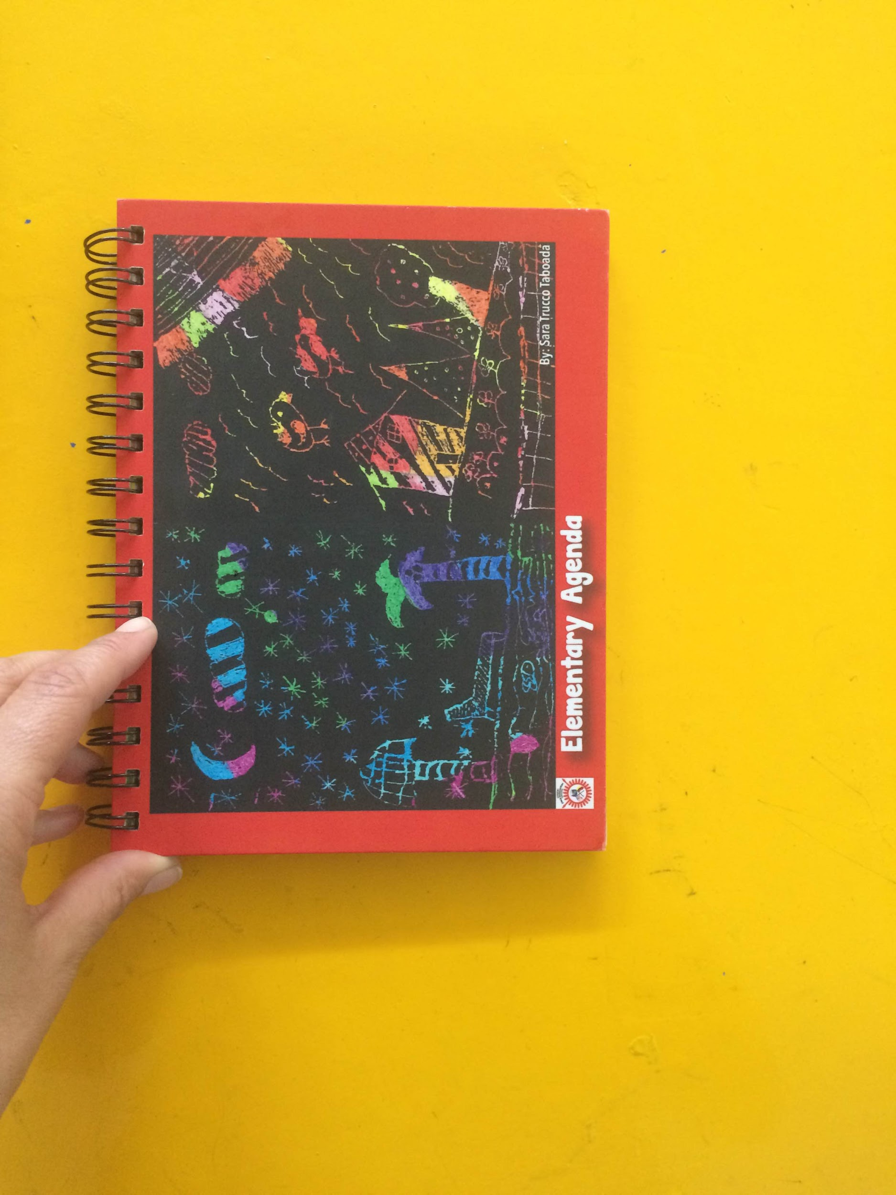
AGENDA COMES TO SCHOOL EVERYDAY!

Slide 13
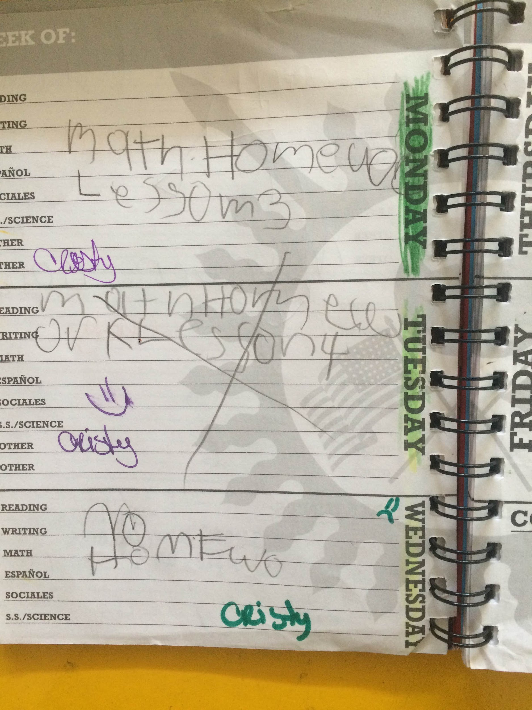
Please sign each day and make sure you talk with your child about their behavior!

Slide 14
BEHAVIOR COLOR CHART
Purple- I had an AMAZING Day in 1A and showed excellent behavior and I deserve an ice cream when I go home! =) =)
Green- I followed all the rules in class and had a great day in class. =)
Yellow- I had some trouble following all the rules of the class and had to have a private talk with my teacher. =(
Red- I did not have a good day and was not following the rules of the class. I had to miss a recess or go talk to Mr. Glab or Ms. Angie. =( =(

Slide 15
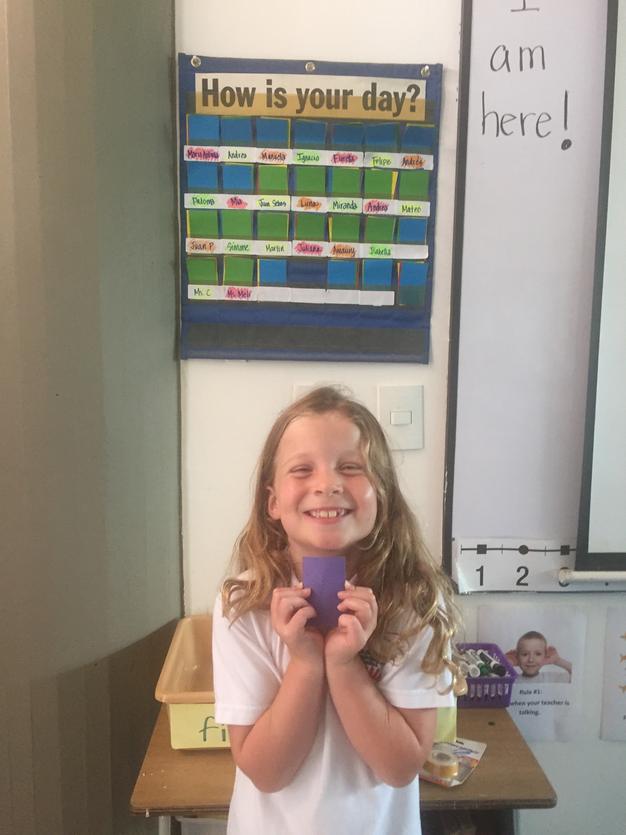

Slide 16
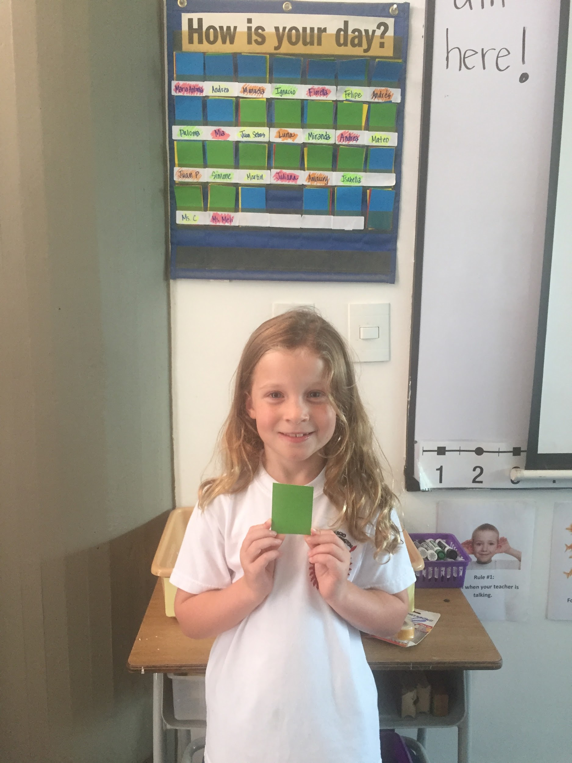

Slide 17
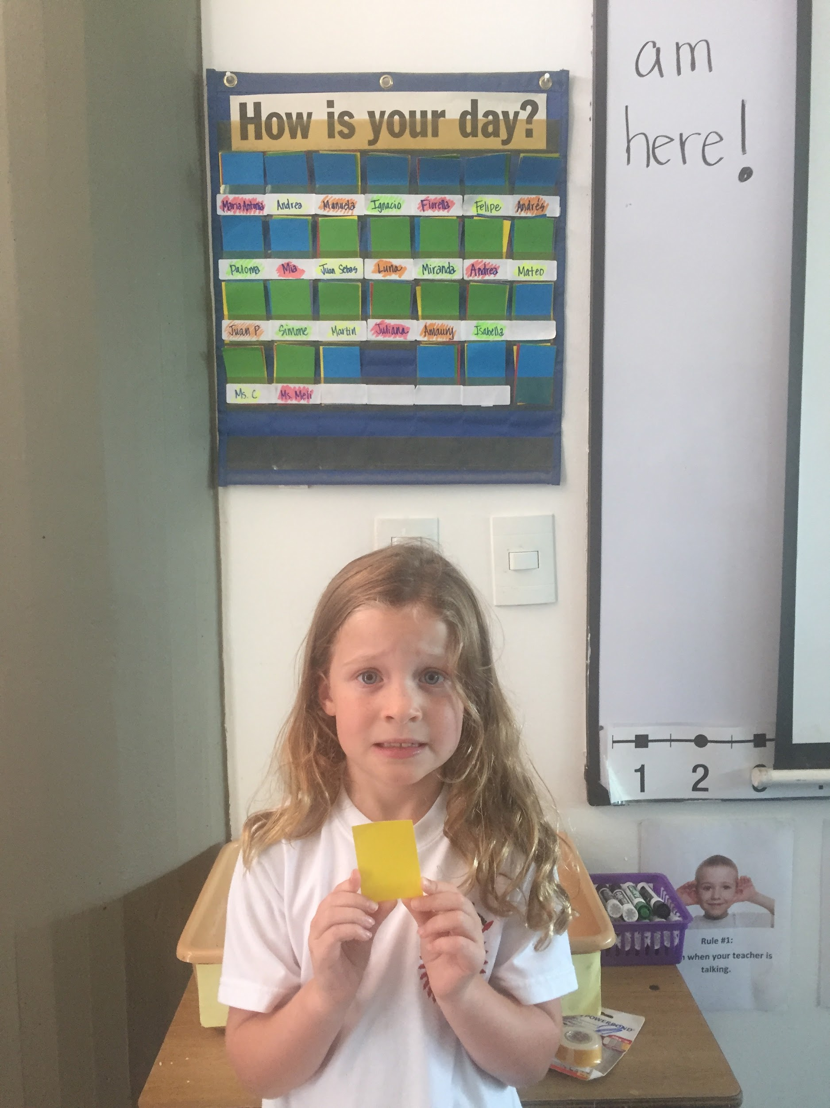

Slide 18
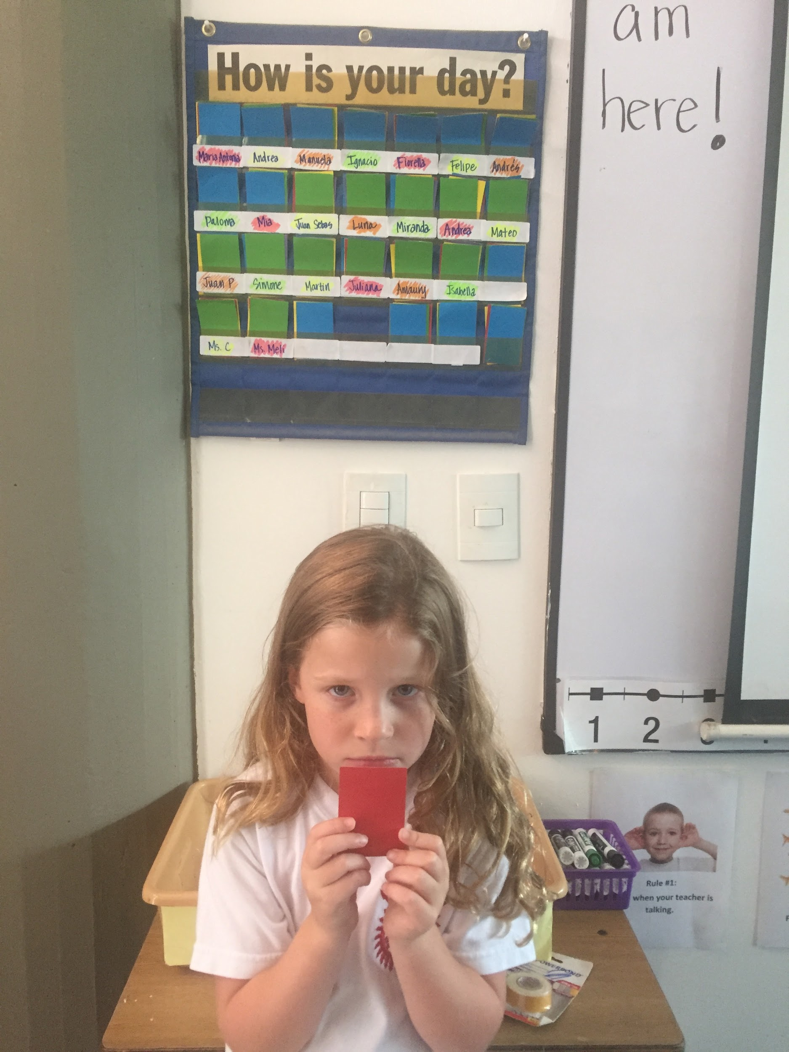

Slide 19
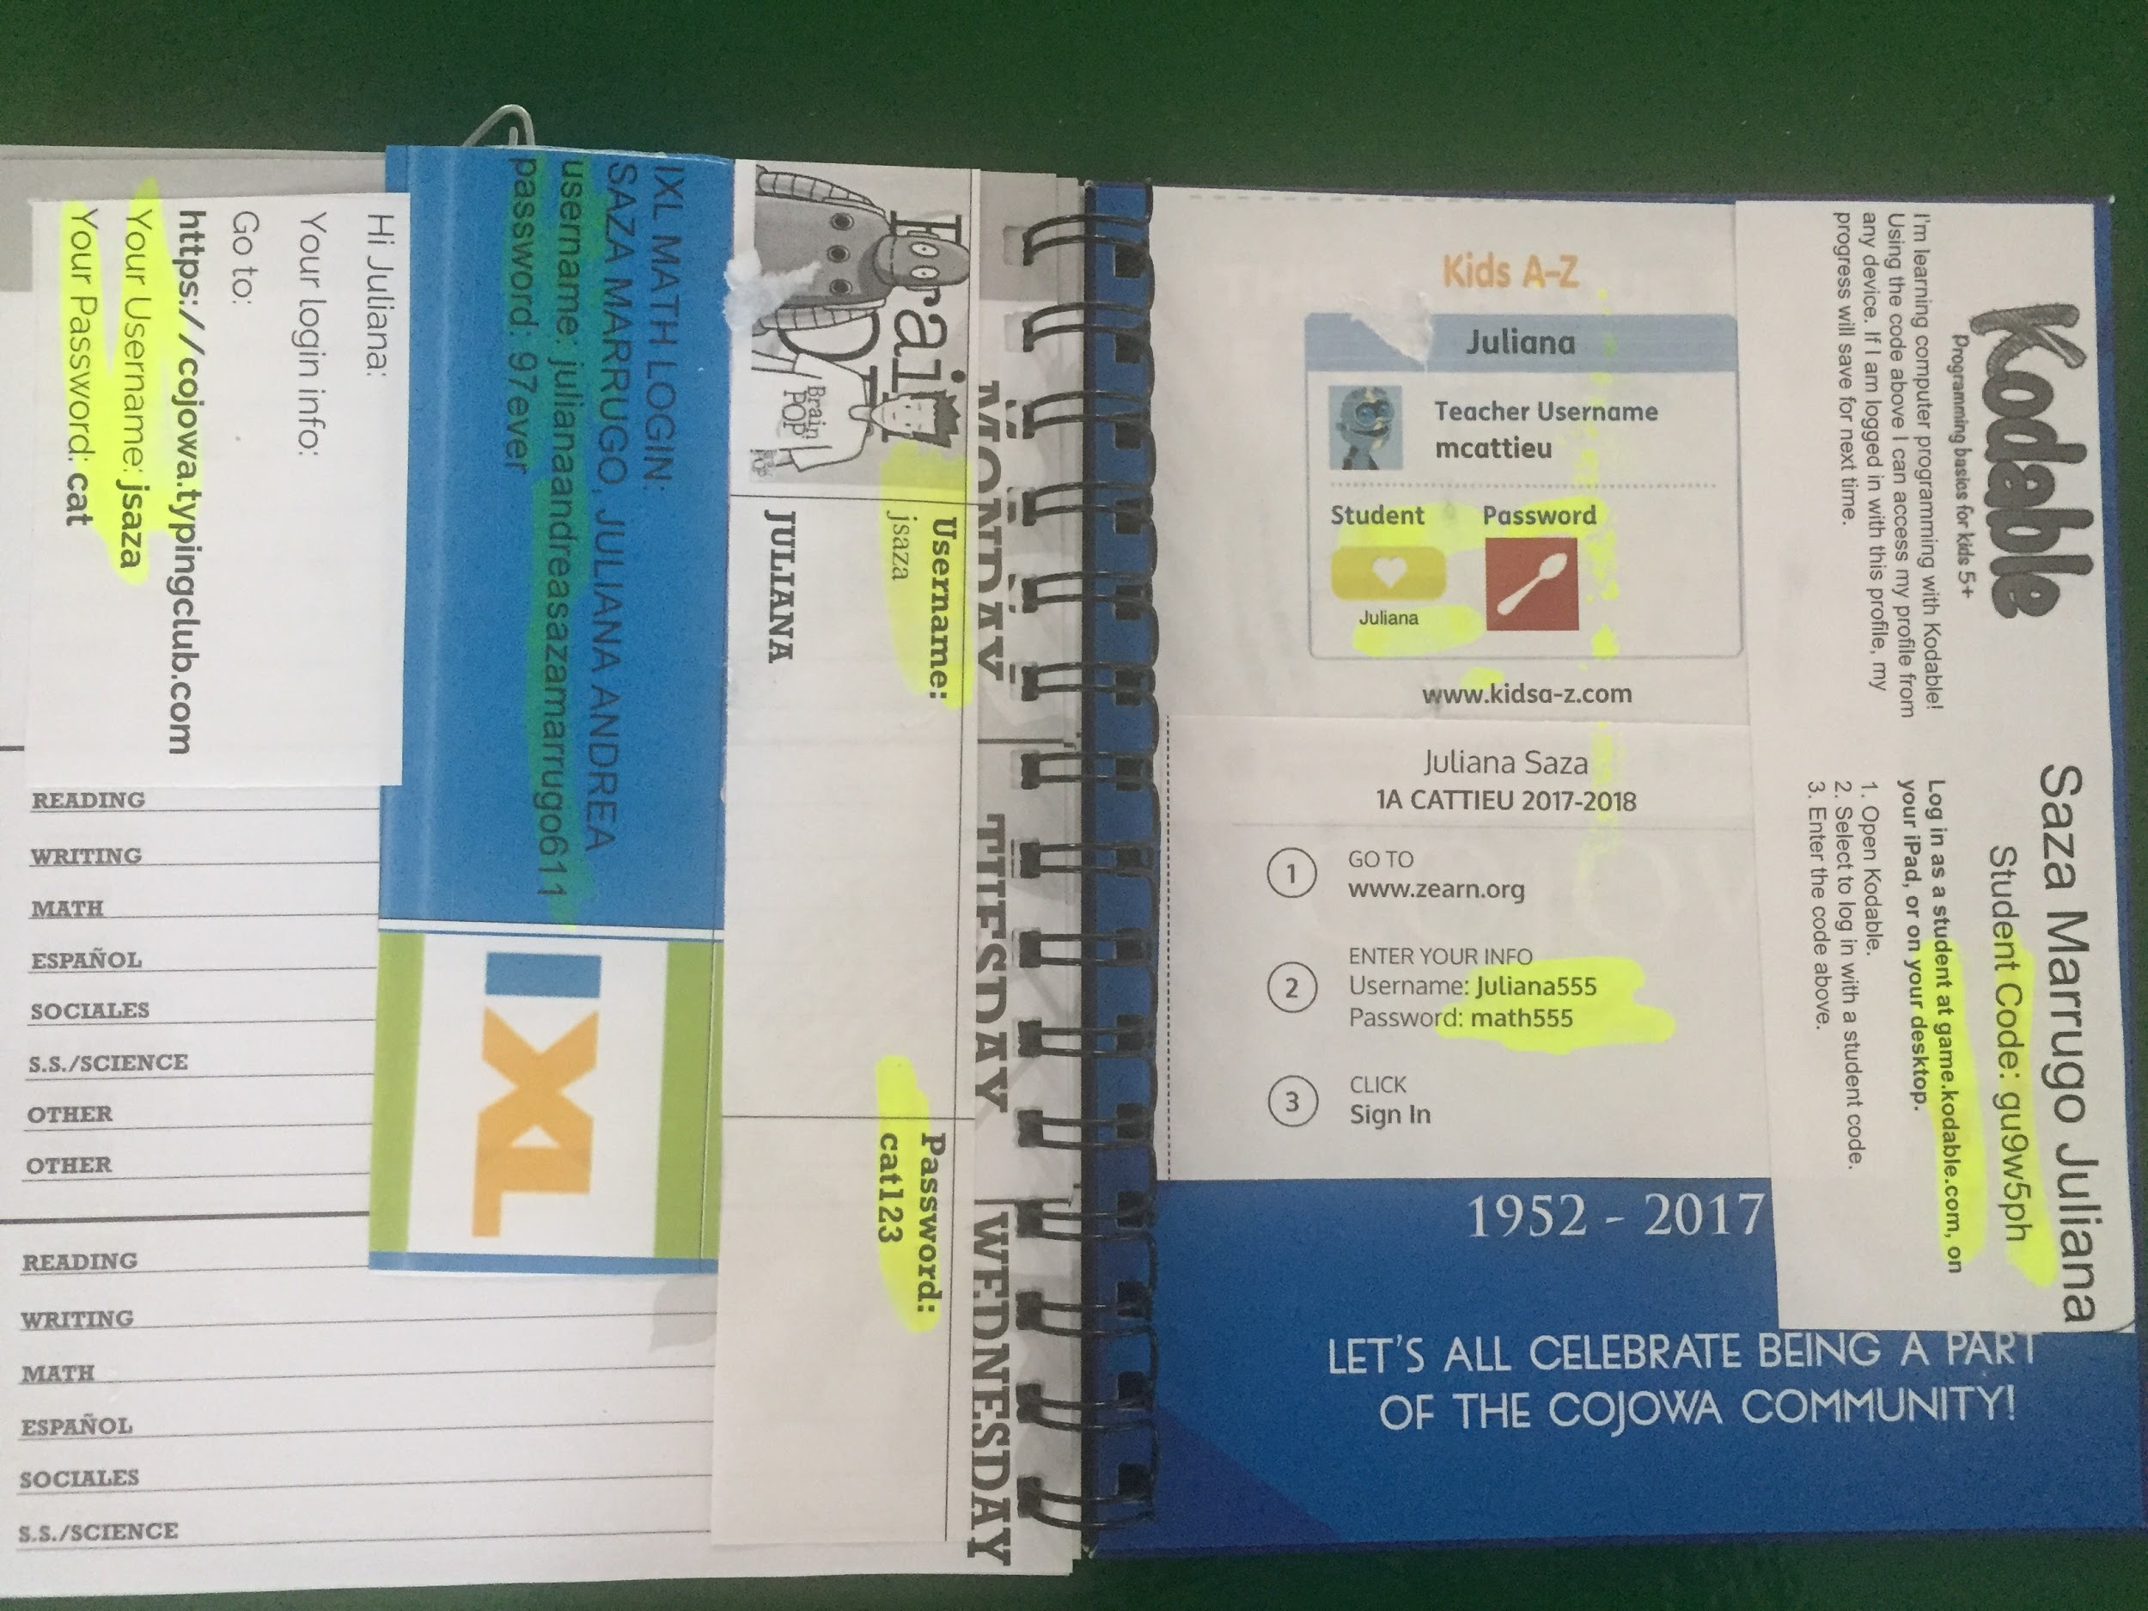
In the BACK of the Agenda,you will find all the passwords for our Online Platforms:

Slide 20
Standards Based Link
Here you can find a link to all the ¨I CAN...¨statements which correspond to each standard that will be covered this year in 1A!

Slide 21
The students will be assessed based on the Common Core State Standards for Math and Language Arts. For Science, we will use the Next Generation Science Standards and for Social Studies we will use the Colorado State Standards.
Students will be assessed after a series of lessons, so please be sure to look at students work that gets sent home in order to see where students are struggling and or doing well!

Slide 22
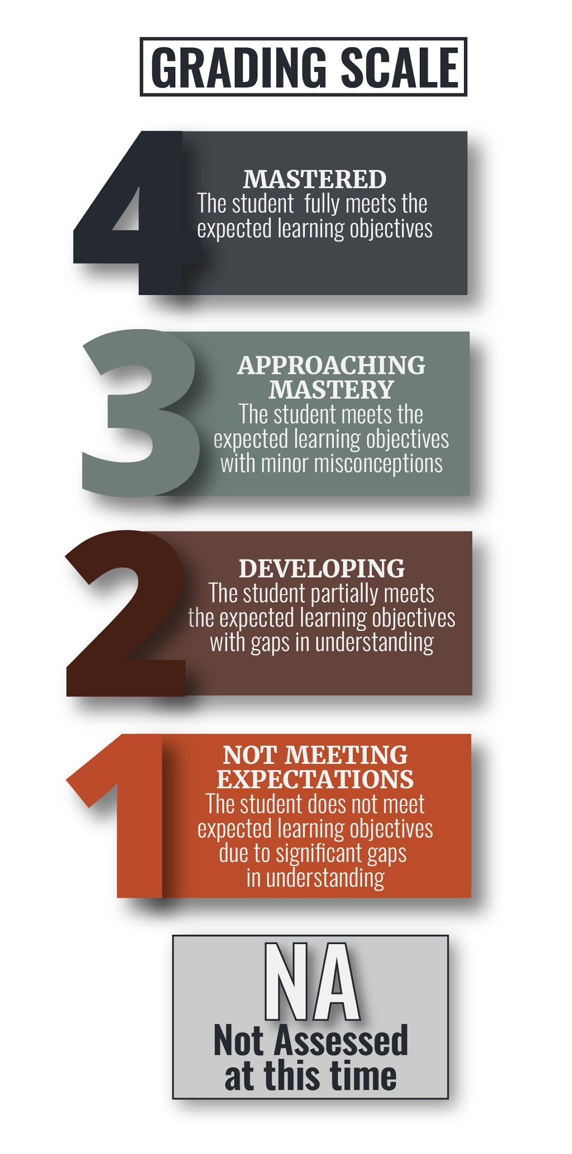
Standards Based Grading

Slide 23
Raz Kids
RazKids

Slide 24
IXL MATH
https://eu.ixl.com/math/

Slide 25
Zearn
https://www.zearn.org/

Slide 26
BrainPop
https://www.brainpop.com/

