Slide 1
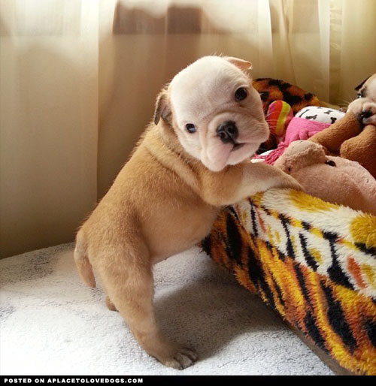
too
t
o
o
He wants to play, too!

Slide 2
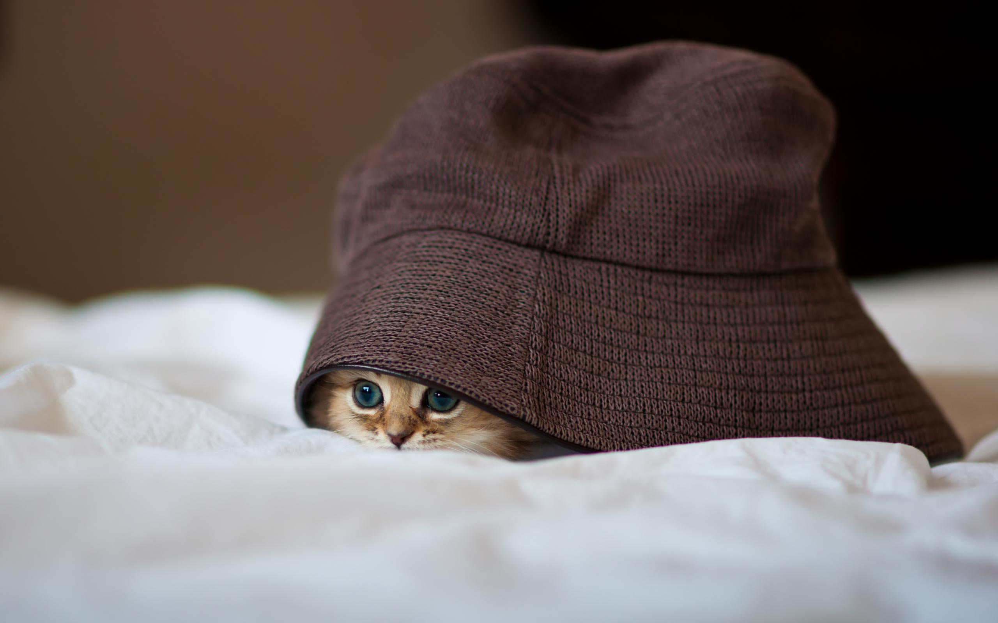
under
u
n
d
e
r
There is something under that hat!

Slide 3
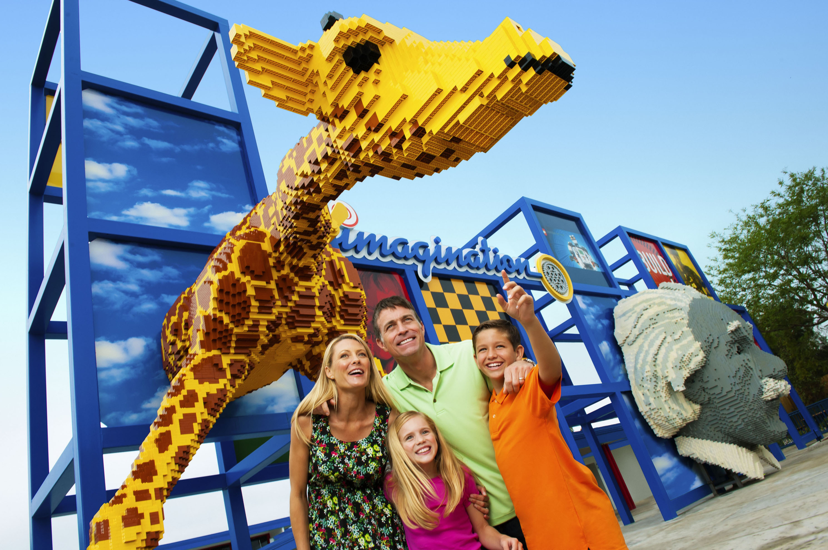
want
w
a
n
t
I want to visit Legoland!

Slide 4
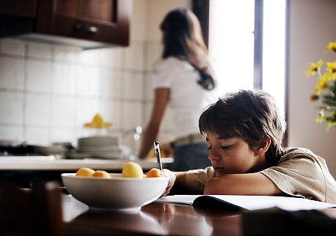
was
w
a
s
Yesterday I was at home.

Slide 5
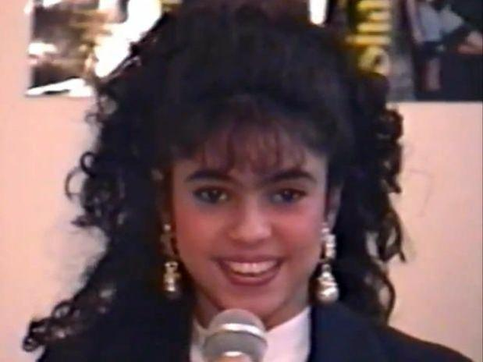
well
w
e
l
l
She sings very well.

