Slide 1
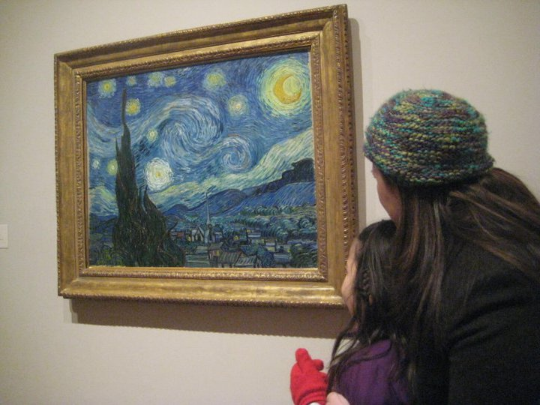
see
s
e
e
I see a beautiful picture.

Slide 2
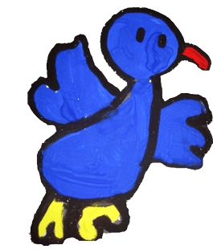
the
t
h
e
The bird is flying.

Slide 3
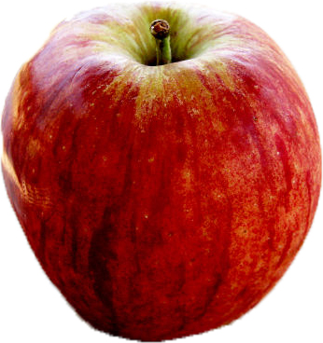
three
t
h
r
e
e
There are three apples.

Slide 4
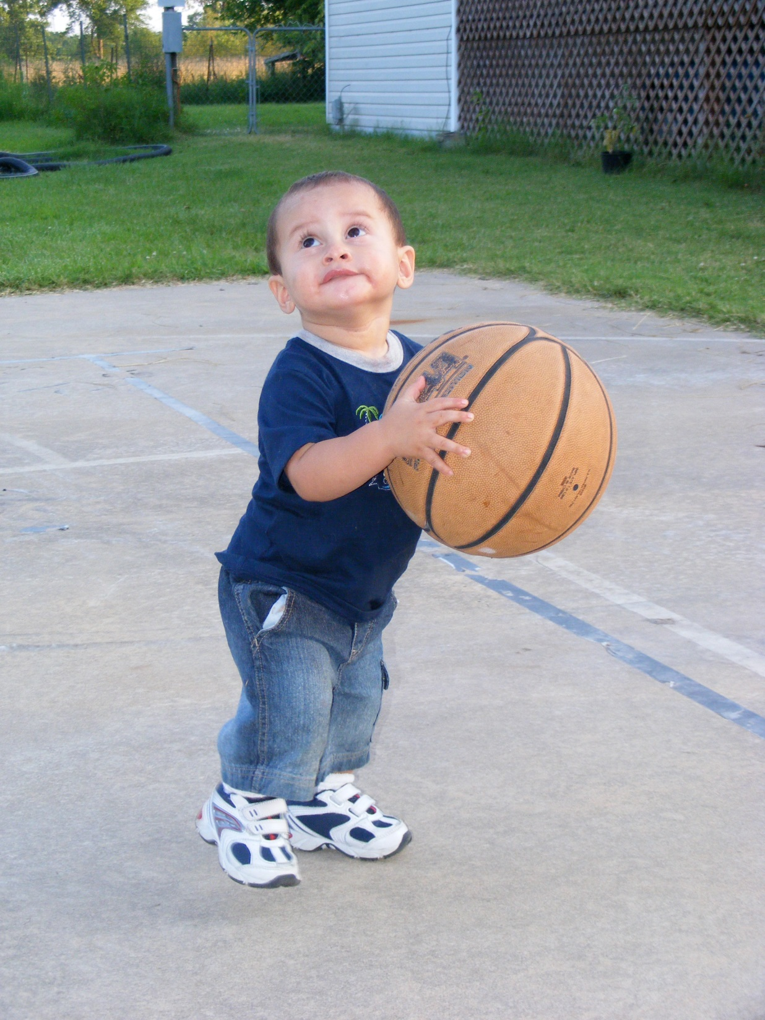
to
t
o
He wants to play basketball.

Slide 5
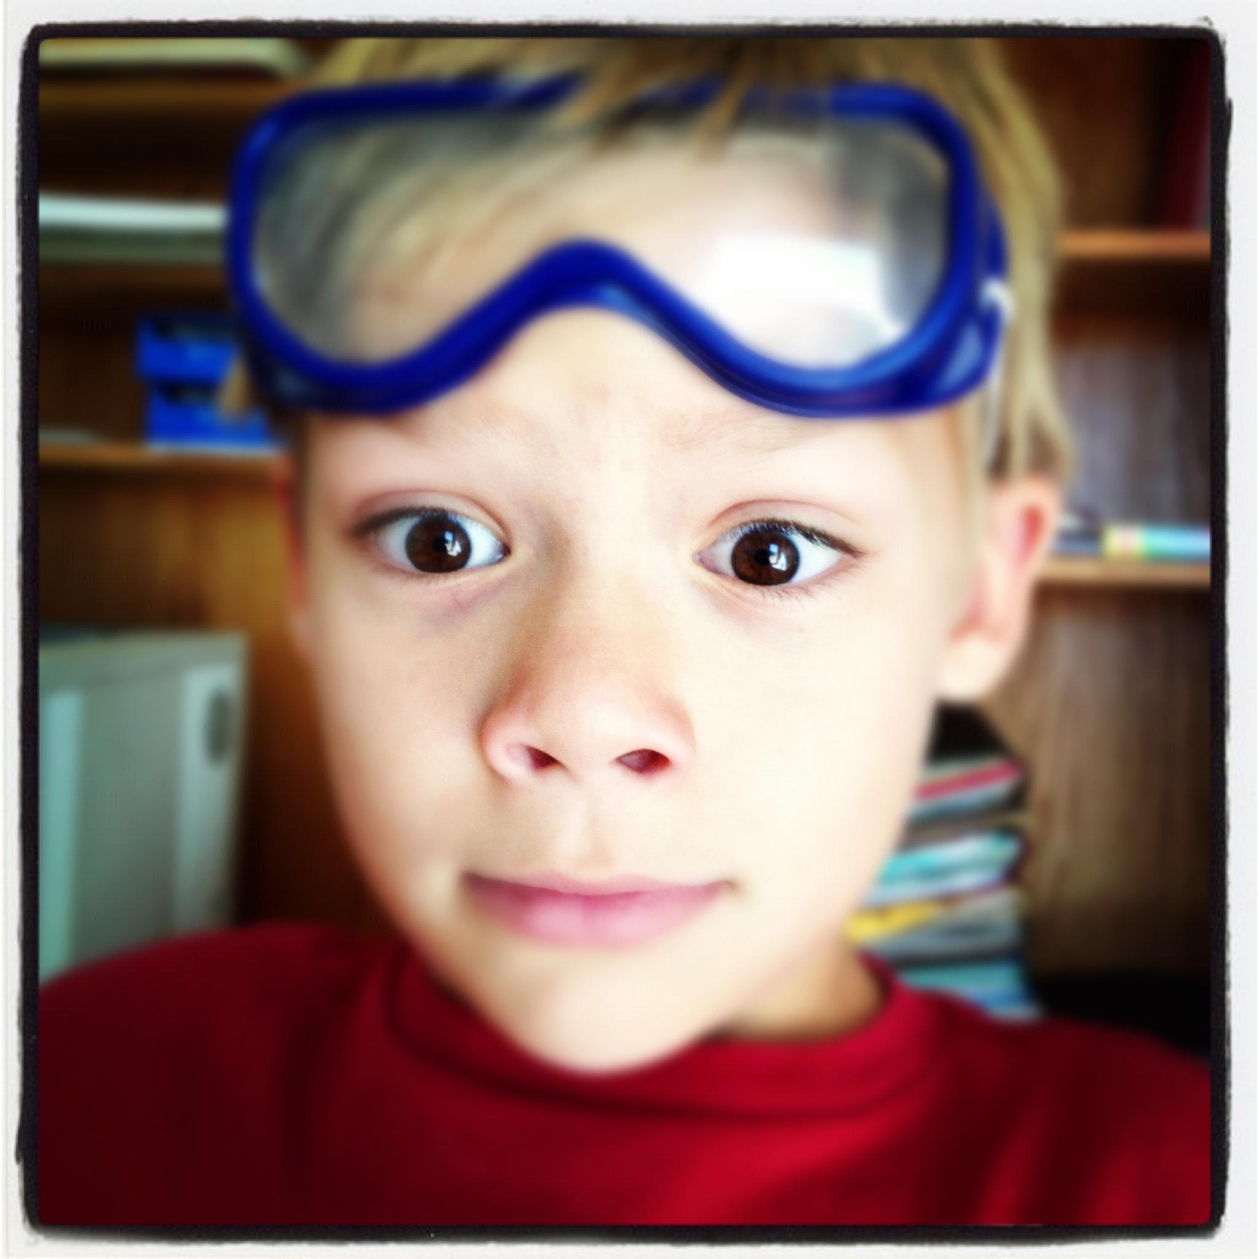
two
t
w
o
I have two eyes.

