Slide 1
up
u
p
I am growing up.

Slide 2
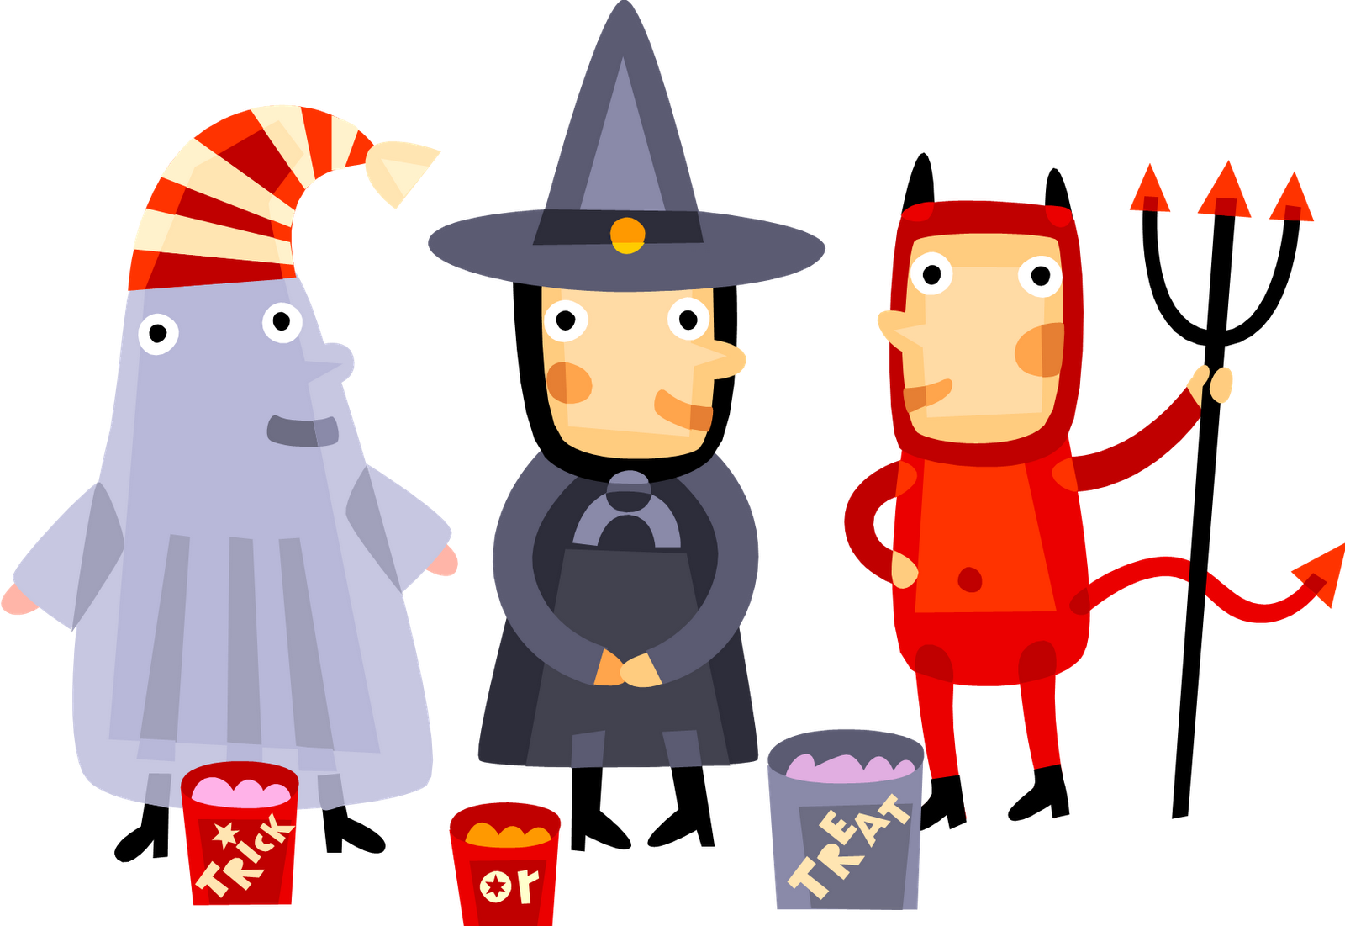
we
w
e
We are having a Halloween party.

Slide 3
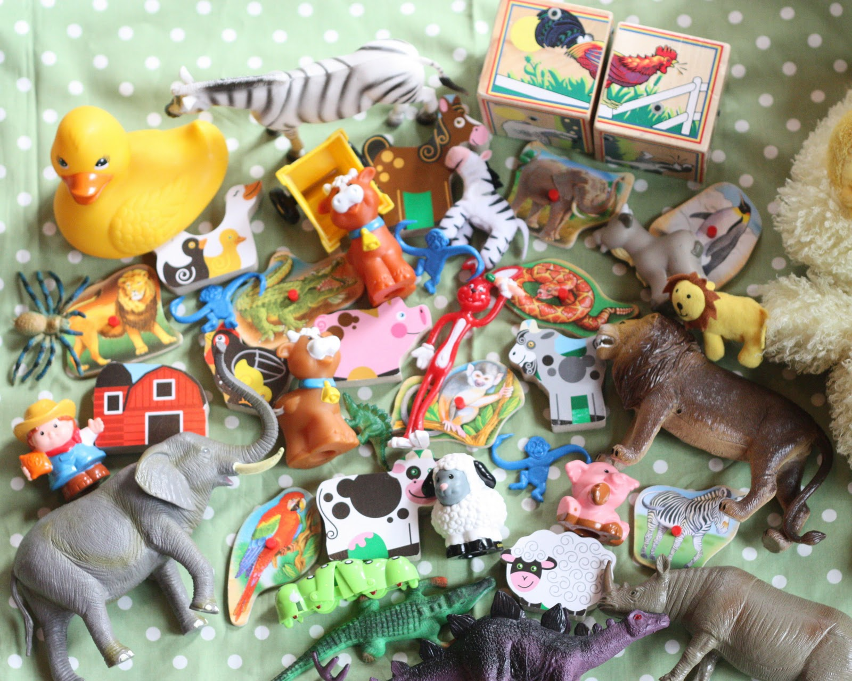
where
w
h
e
r
e
Where is the lion?

Slide 4
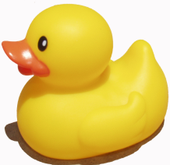
yellow
y
e
l
l
o
w
The yellow duck is small.

Slide 5
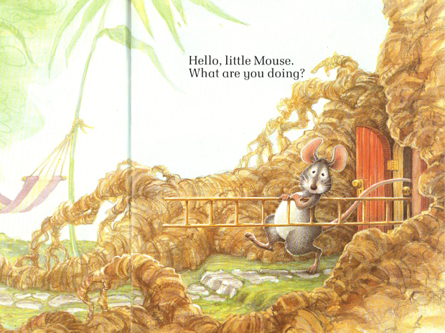
you
y
o
u
What are you doing?

