Slide 1
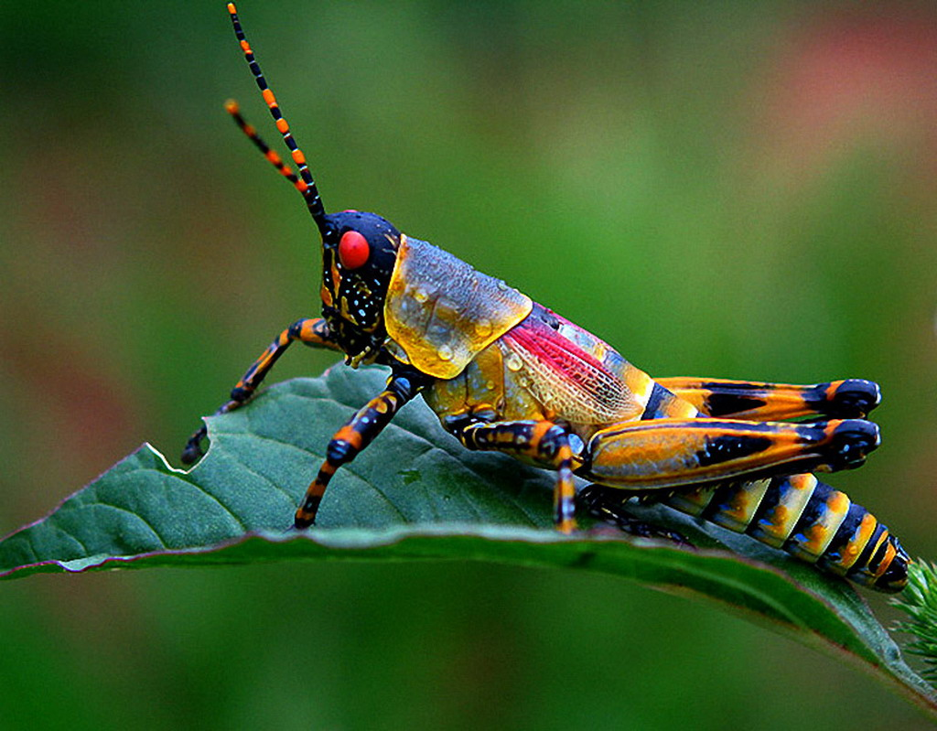
all
a
l
l
I respect all kinds of animals.

Slide 2
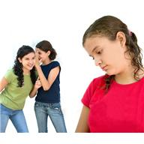
am
a
m
I am learning about empathy.

Slide 3
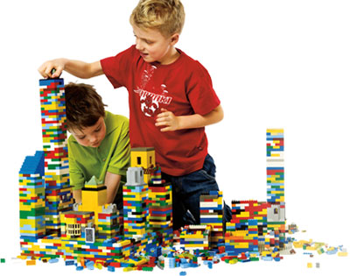
are
a
r
e
They are playing with legos.

Slide 4
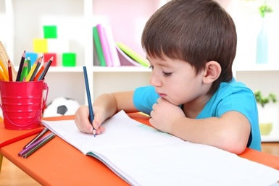
at
a
t
He is doing his homework at home.

Slide 5
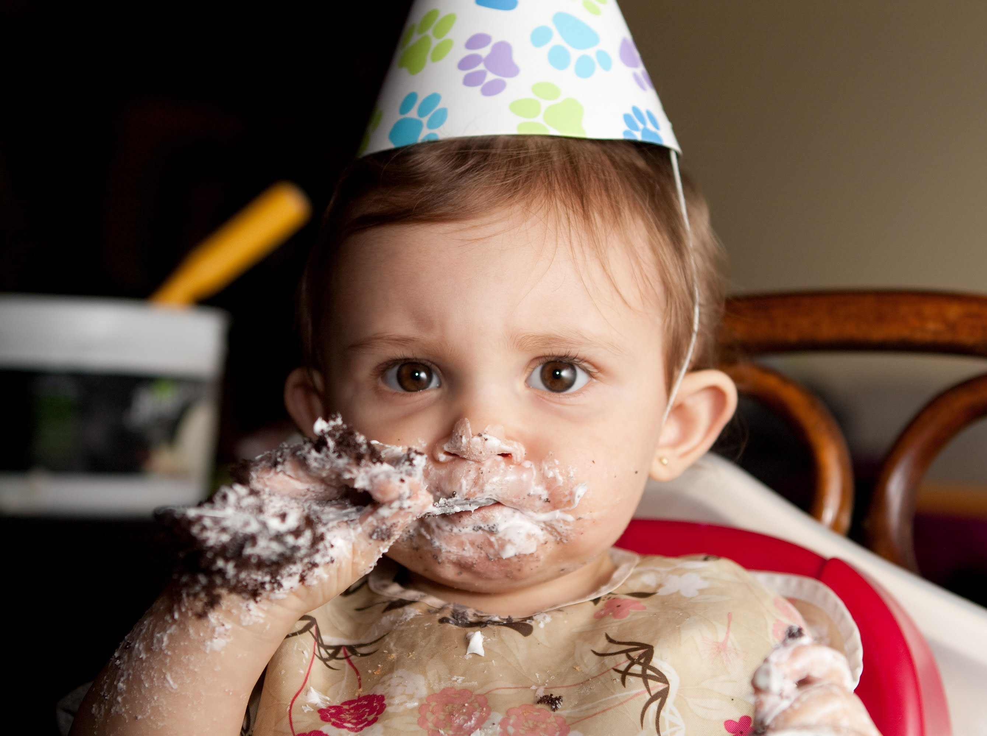
ate
a
t
e
He ate some cake.

