Slide 1
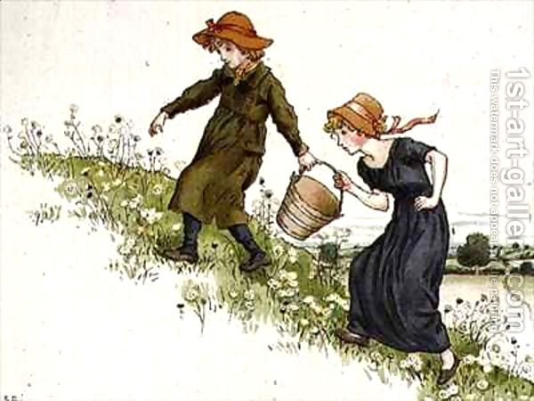
hill
h
i
l
l
Jack and Jill went up the hill
to fetch a pail of water.

Slide 2
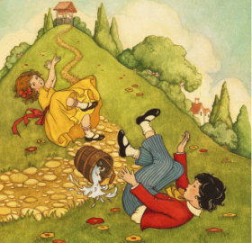
fell
f
e
l
l
Jack fell down, and broke his crown
and Jill came tumbling after.

Slide 3
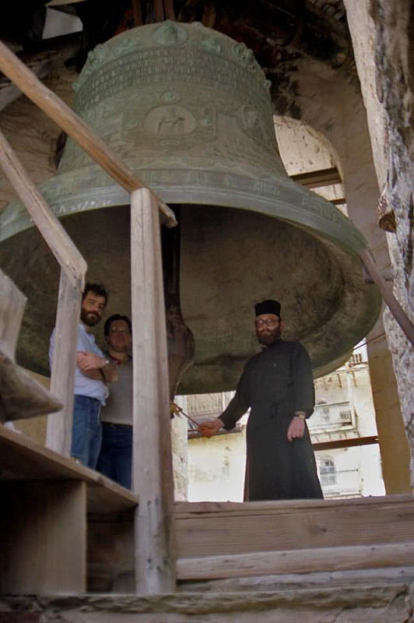
bell
b
e
l
l
What a huge bell!

Slide 4
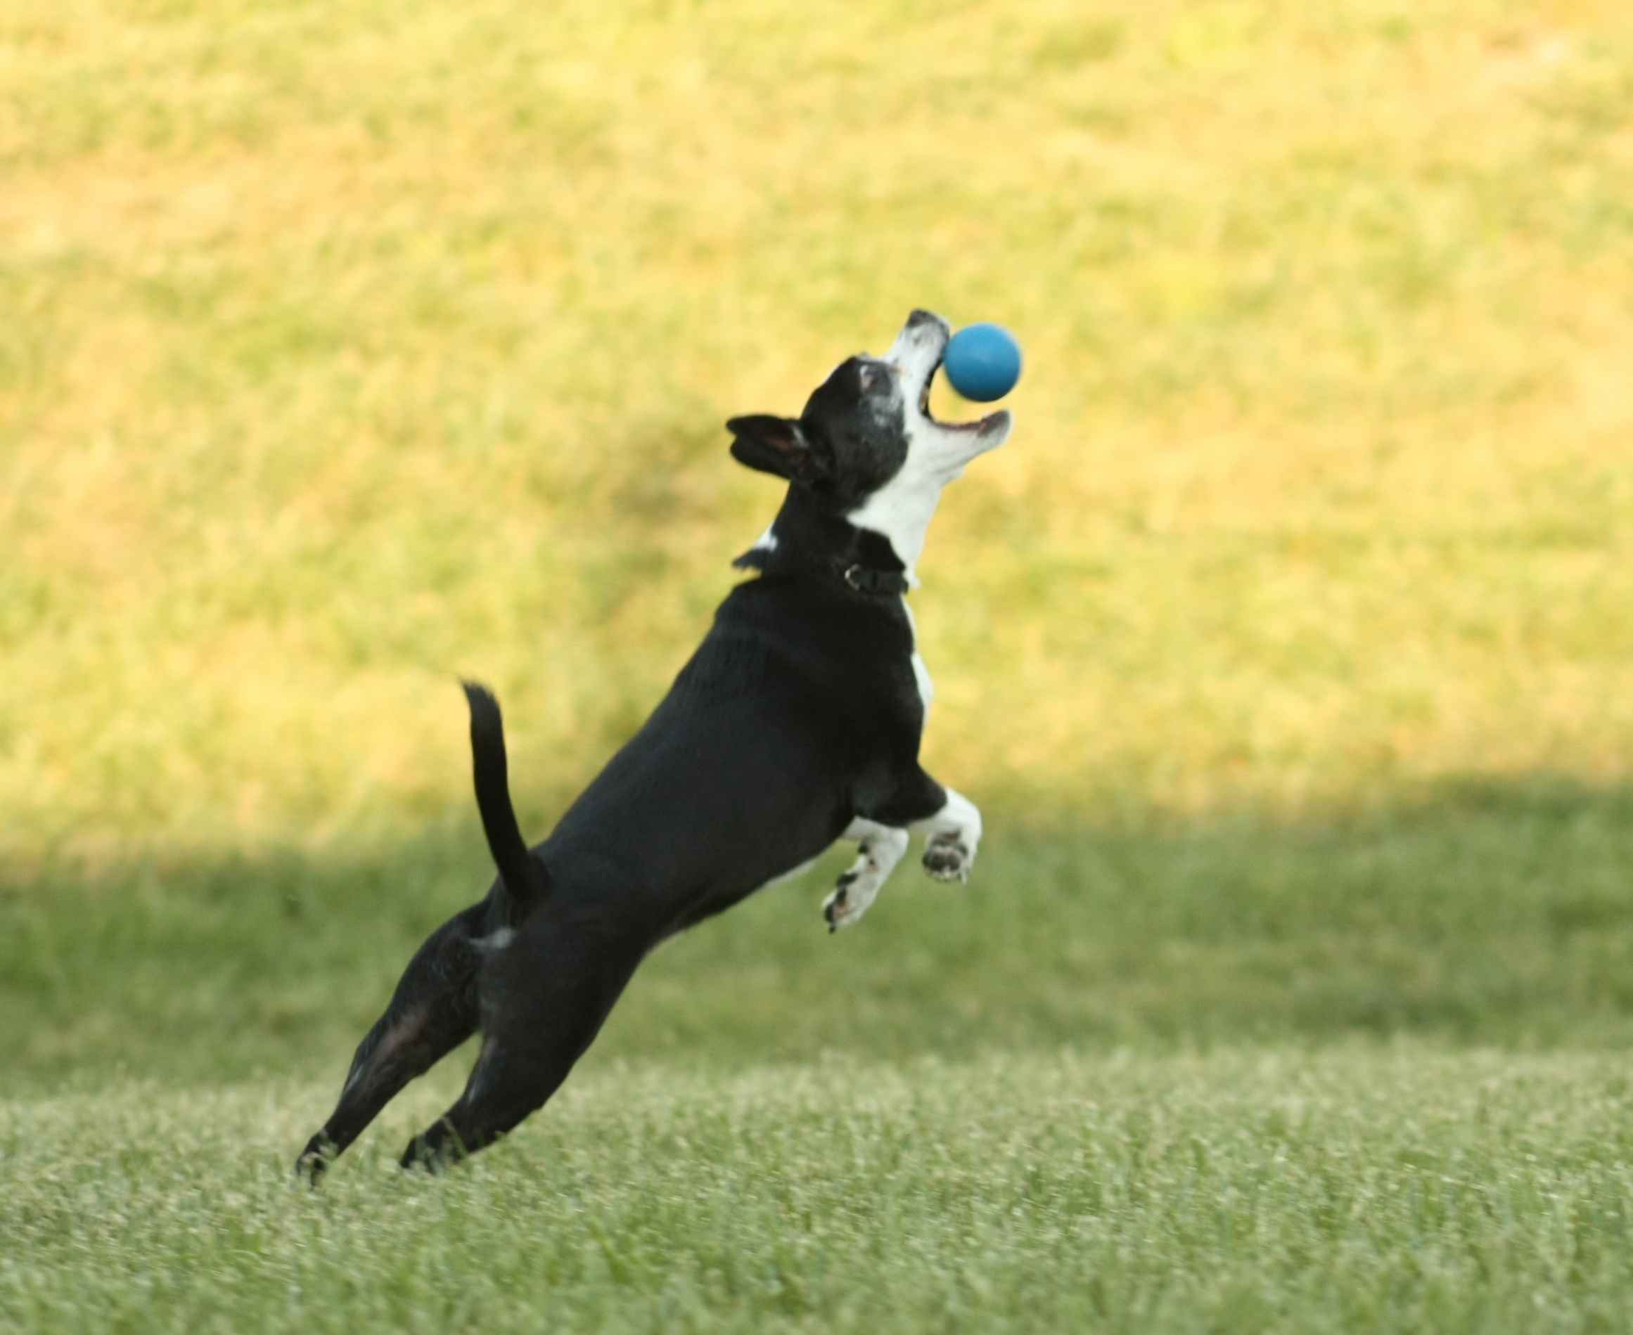
ball
b
a
l
l
He is catching the ball.

Slide 5
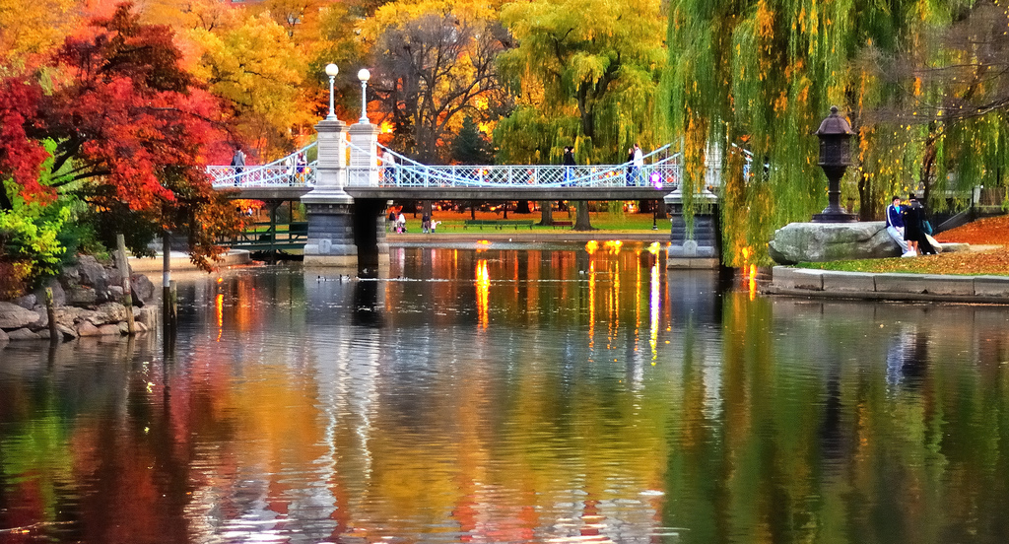
fall
f
a
l
l
This is how fall looks like in Boston.

